Slide 1

Research Progress Report

Slide 2
Research Objectives
Evaluate HV mean reversion strategy. Use short-term HV - long-term HV (e.g., HV5 - HV20) as a signal to predict ATM volatility movements.
Compare different HV parameters (HV5, 10, 20, 30).
Compare short-term vs. long-term trading.
Compare different trade intervals (30, 60, 120 minutes) in short-term trading.
Analyze the impact on different assets (M, CU, AG, SA, I, SC).

Slide 3
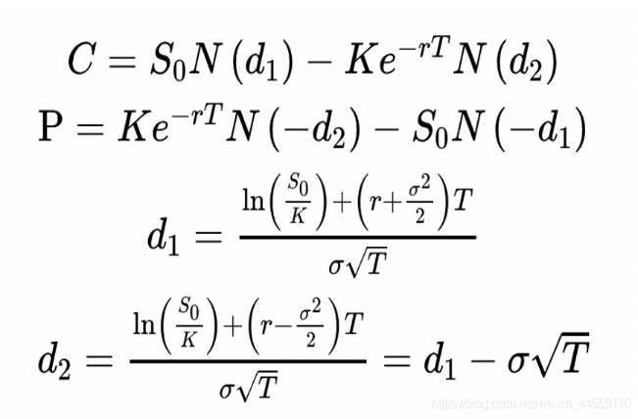

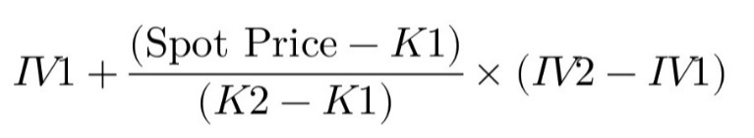
ATM VOL Data Processing
Calculate implied volatility (imp vol) using BSM model:
Select the nearest-month contract as the primary contract and roll over three days before expiration. Data is taken from daily tick 14:56-14:57.
Key variables:
C/P: Mid-price of the option
T: (Expiration date - trade date) / Total trading days in a year
S: Mid-price of the futures
K: Two closest strike prices around the futures price (K1 ≤ S ≤ K2)
r: 0
2. atm vol =

Slide 4
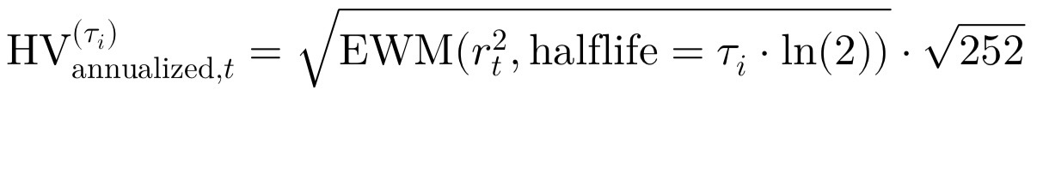
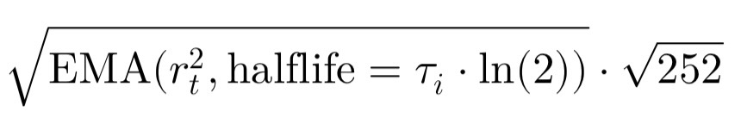
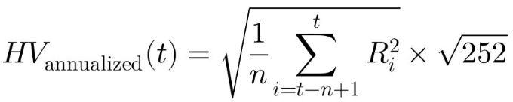
HV Data Processing
For HV I used：
Exponentially Weighted Moving Average (EMA) for HV Calculation:
rt: where P is the futures closing price.
Tau values: (5, 10, 20, 30)
In place of:
Traditional Equal-Weighted HV Calculation:
n: (5, 10, 20, 30)
Ri = In (Pt / Pt-1)

Slide 5
Grid Trading Logic (Adaptive Scaling)
if position = 0：
if signal <= - (alpha+1) * step，open a long (buy) position:
position = (abs(signal) – step * alpha)/step
if signal >= (alpha+1) * step，open a short (sell) position:
position = - (abs(signal) – step * alpha)/step
if position < 0:
if signal <= - step， but does not meet reversal condition, reduce short position:
position = min((abs(signal) /step) , - positions[-1])
If signal < - (alpha+1) * step， meets reversal condition:
position = (abs(signal) – step * alpha）/step + abs(positions[-1])
if signal >= step，increase short position:
position = - abs(signal）/step
if position > 0:
if signal >= step， but does not meet reversal condition, reduce long position:
position = - min((abs(signal) /step) , positions[-1])
If signal >= (alpha+1) * step， meets reversal condition:
position = - (abs(signal) – step * alpha）/step + abs(positions[-1])
if signal <= - step，increase long position:
position = abs(signal）/step

Slide 6
signal <= - step, reduce short position / close position
signal >= step， increase short position
signal >=（alpha +1) * step , open a
short (sell) position
signal < -（alpha +1) * step, reverse position:
open a long (buy) position
signal <= - step， increase long position
signal >= step, reduce long position/close position

Slide 7
Short Term Holding

Slide 8
Ag

Slide 9
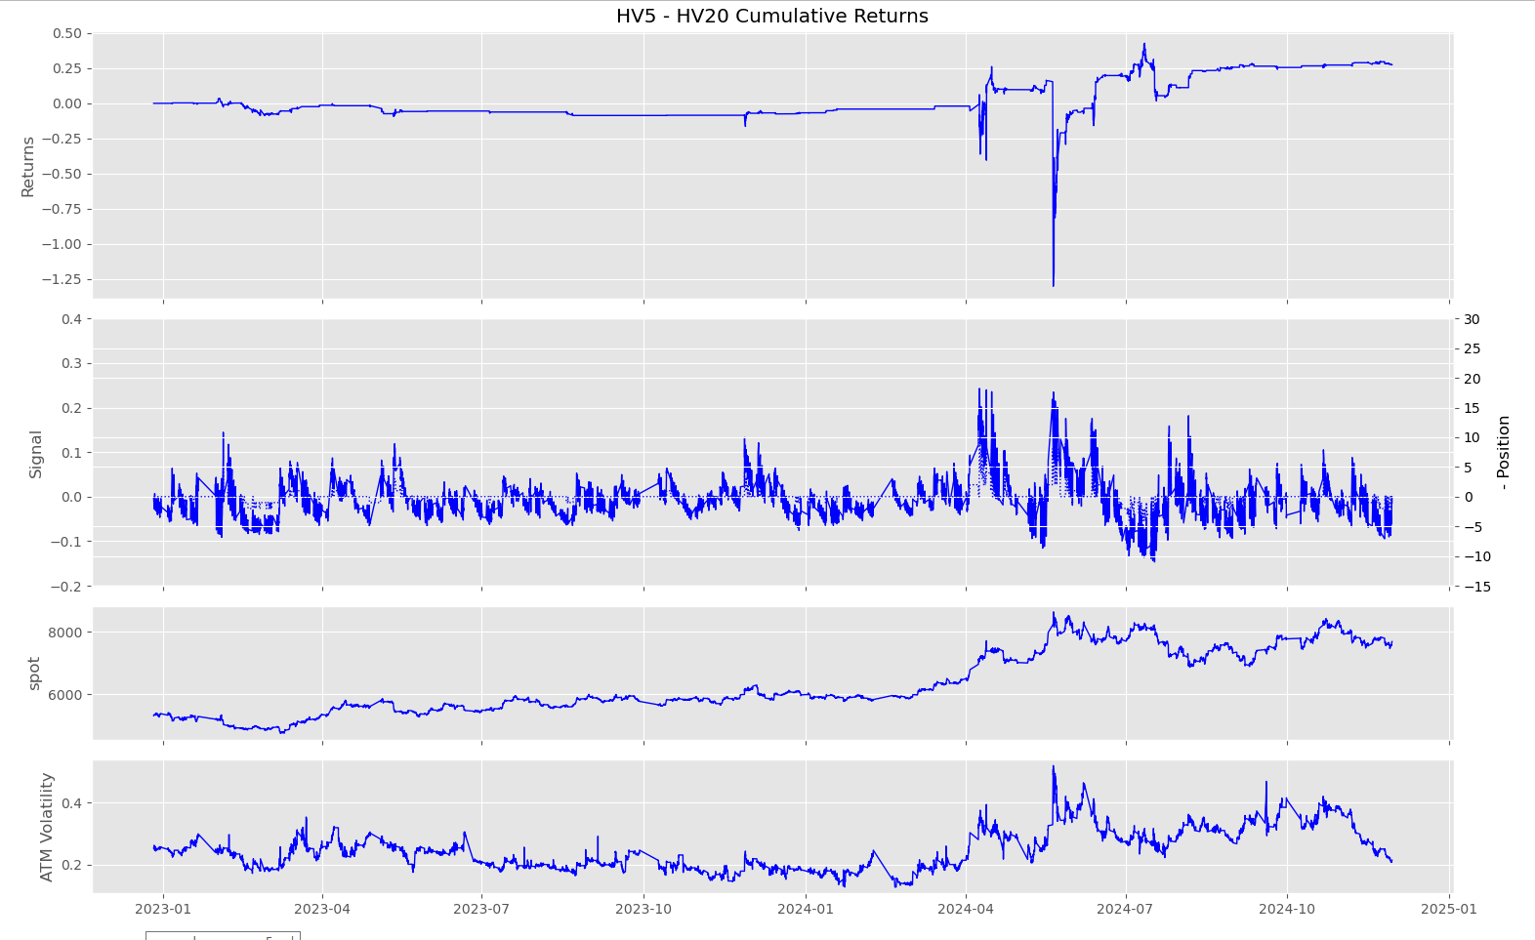
HV5 – HV20
frequency = 30min
alpha = 2
step = 0.02
max drawdown = -1.5653

Slide 10
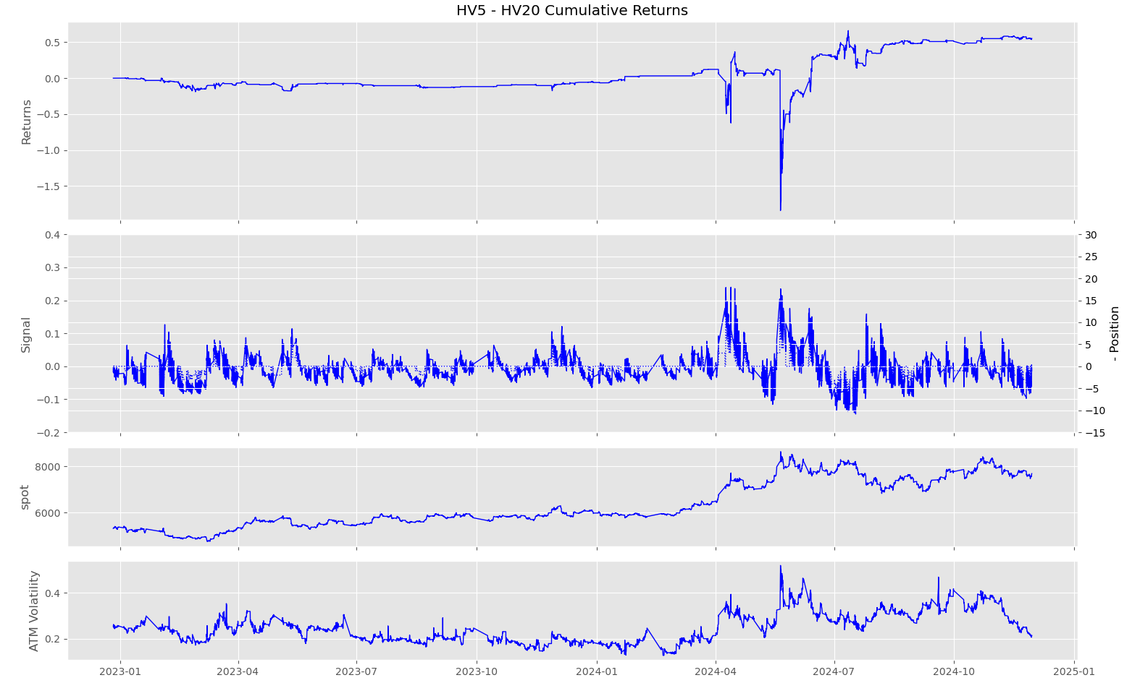
HV5 – HV20
frequency = 60min
alpha = 2
step = 0.02
max drawdown =
-1.5641

Slide 11
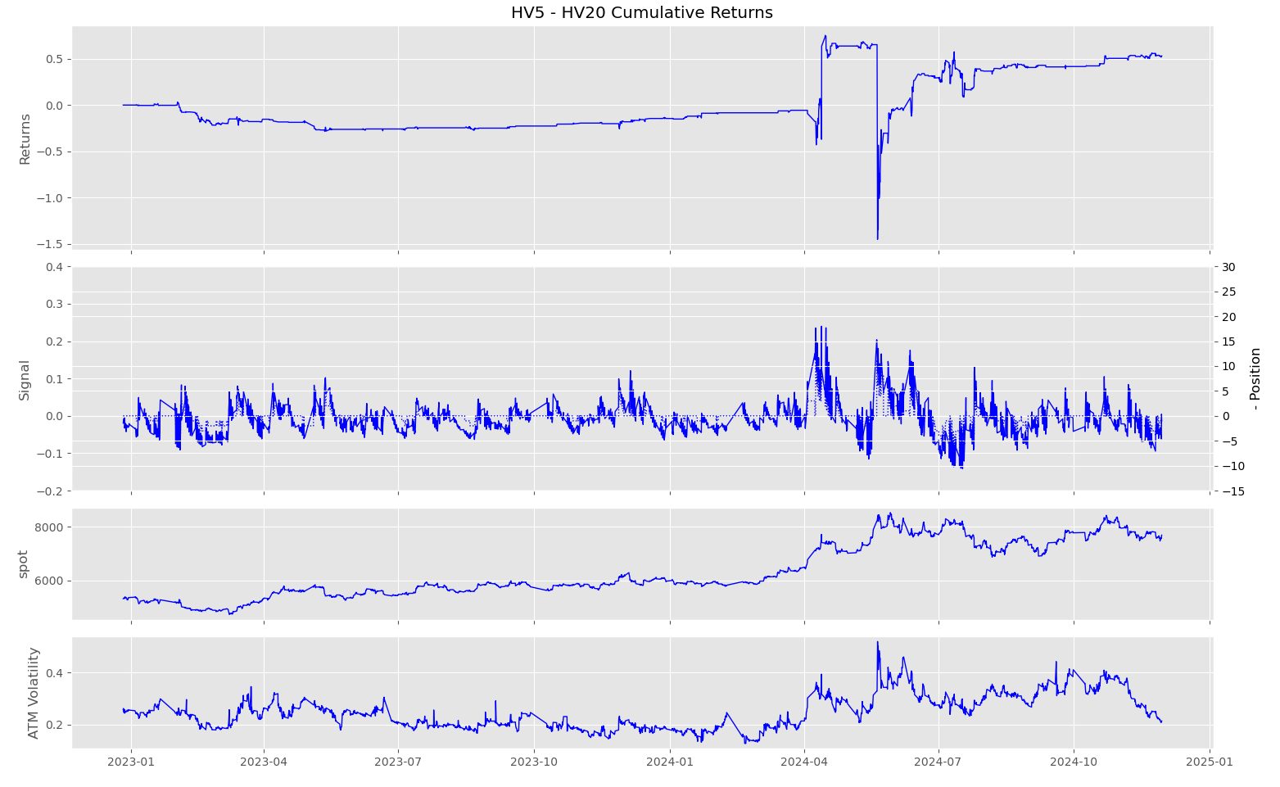
HV5 – HV20
frequency = 120min
alpha = 2
step = 0.015
max drawdown =
-2.2057

Slide 12
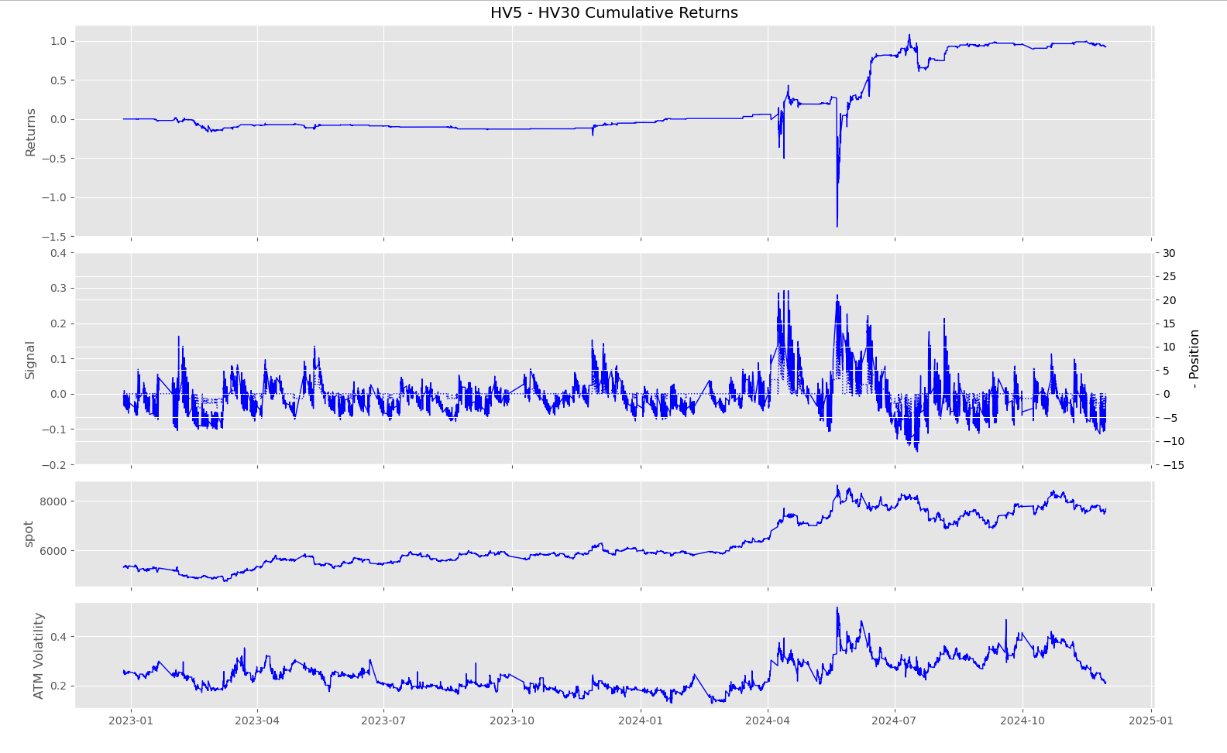
HV5 – HV30
frequency = 30min
alpha = 2
step = 0.02
max drawdown = -1.8133

Slide 13
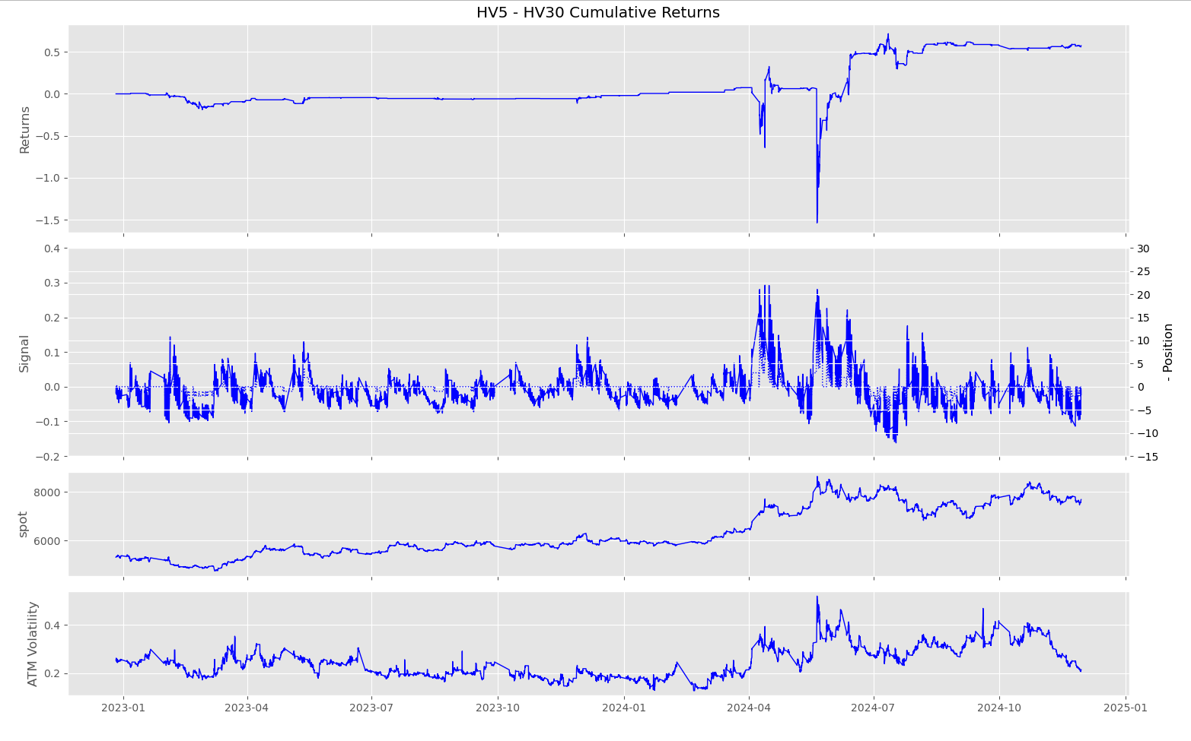
HV5 – HV30
frequency = 60min
alpha = 2
step = 0.02
max drawdown =
-1.8644

Slide 14
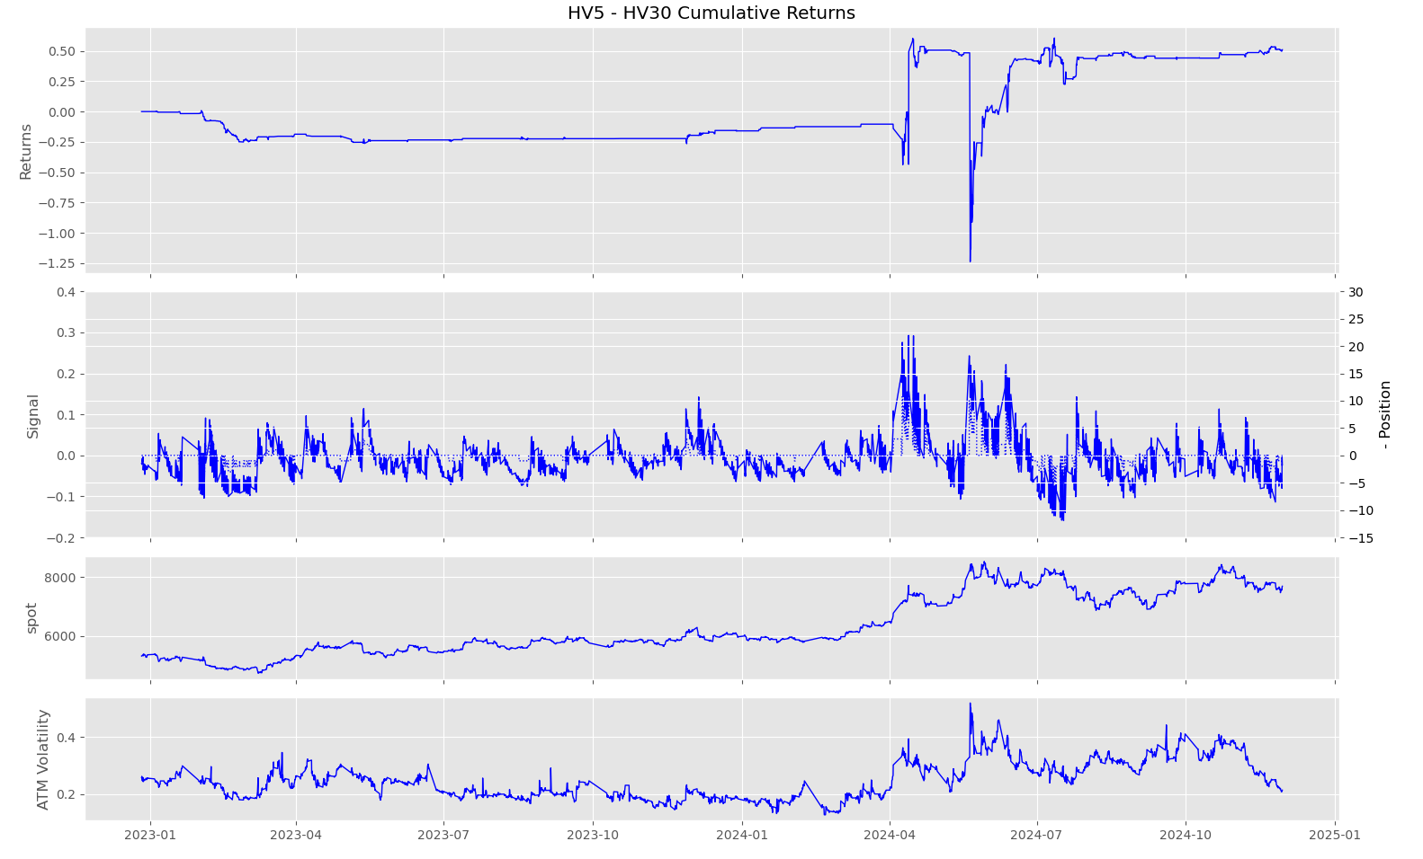
HV5 – HV30
frequency = 120min
alpha = 2
step = 0.02
max drawdown =
-1.8427

Slide 15
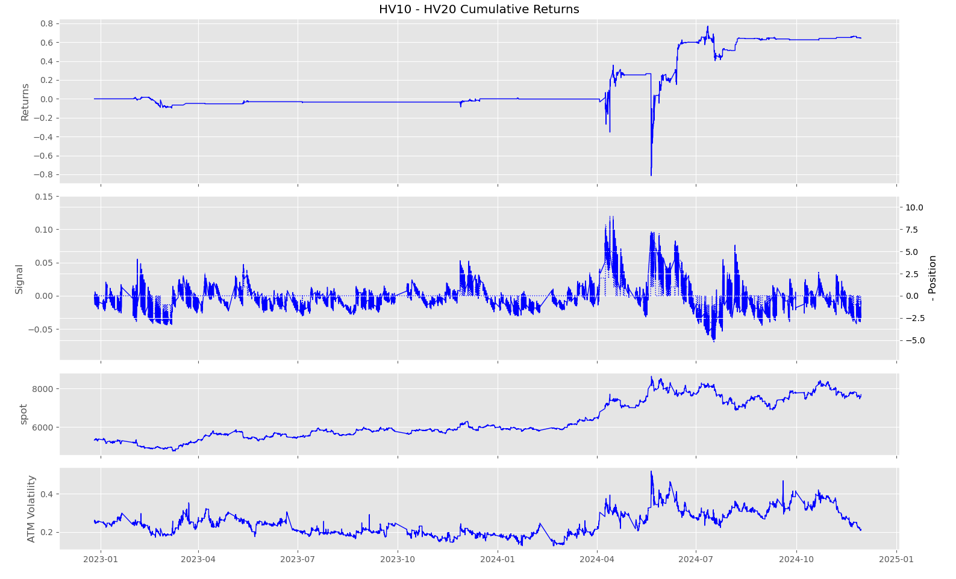
HV10 – HV20
frequency = 30min
alpha = 2
step = 0.01
max drawdown = -1.1722

Slide 16
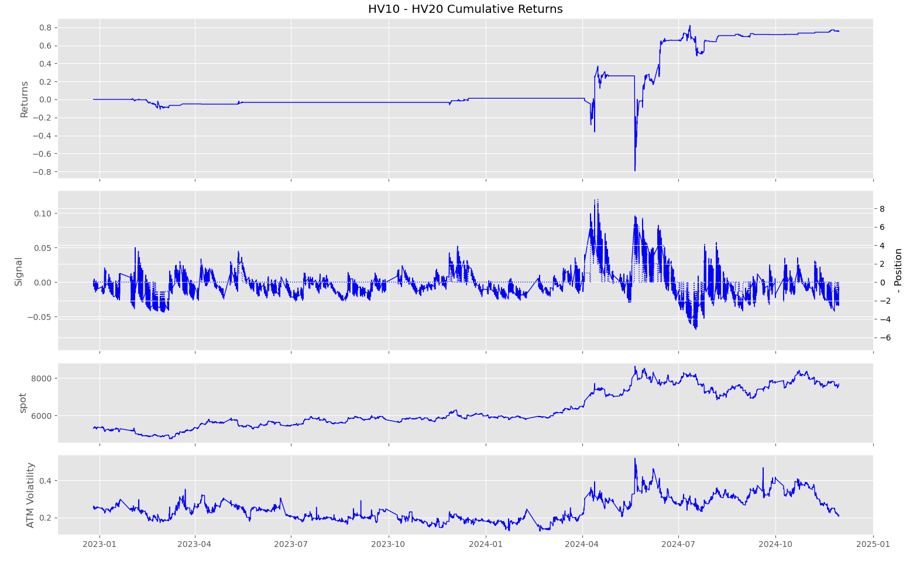
HV10 – HV20
frequency = 60min
alpha = 2
step = 0.01
max drawdown = -1.1659

Slide 17
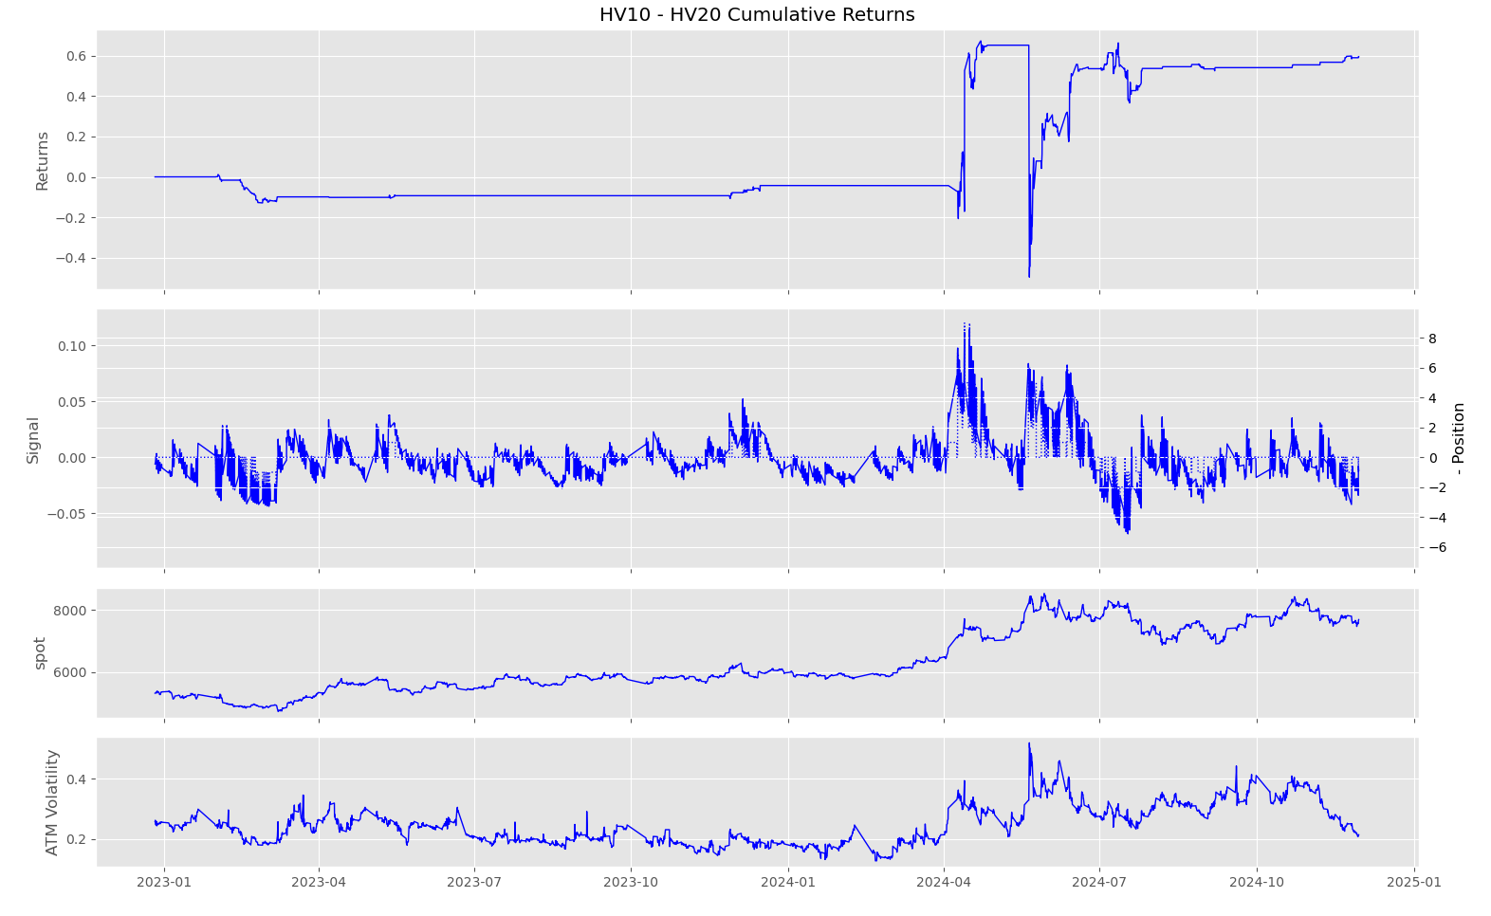
HV10 – HV20
frequency = 120min
alpha = 2
step = 0.01
max drawdown = -1.1694

Slide 18
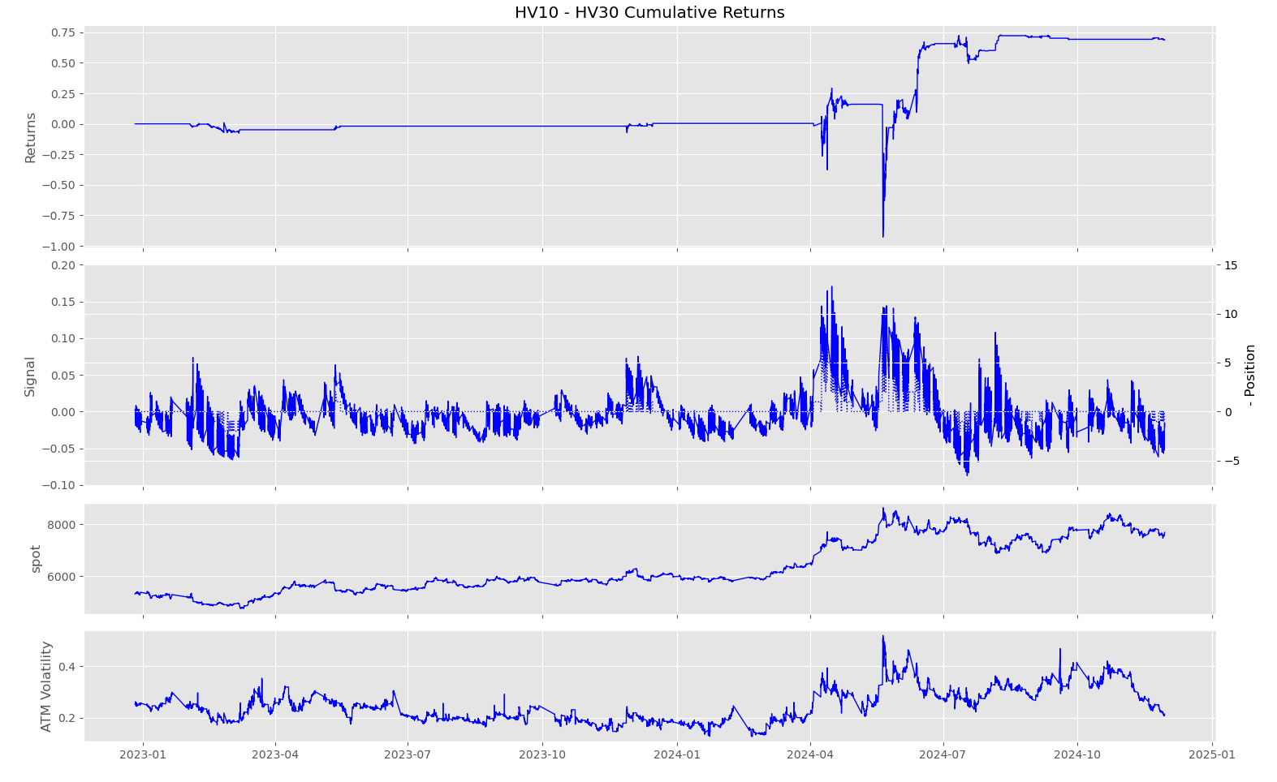
HV10 – HV30
frequency = 30min
alpha = 2
step = 0.015
max drawdown = -1.2198

Slide 19
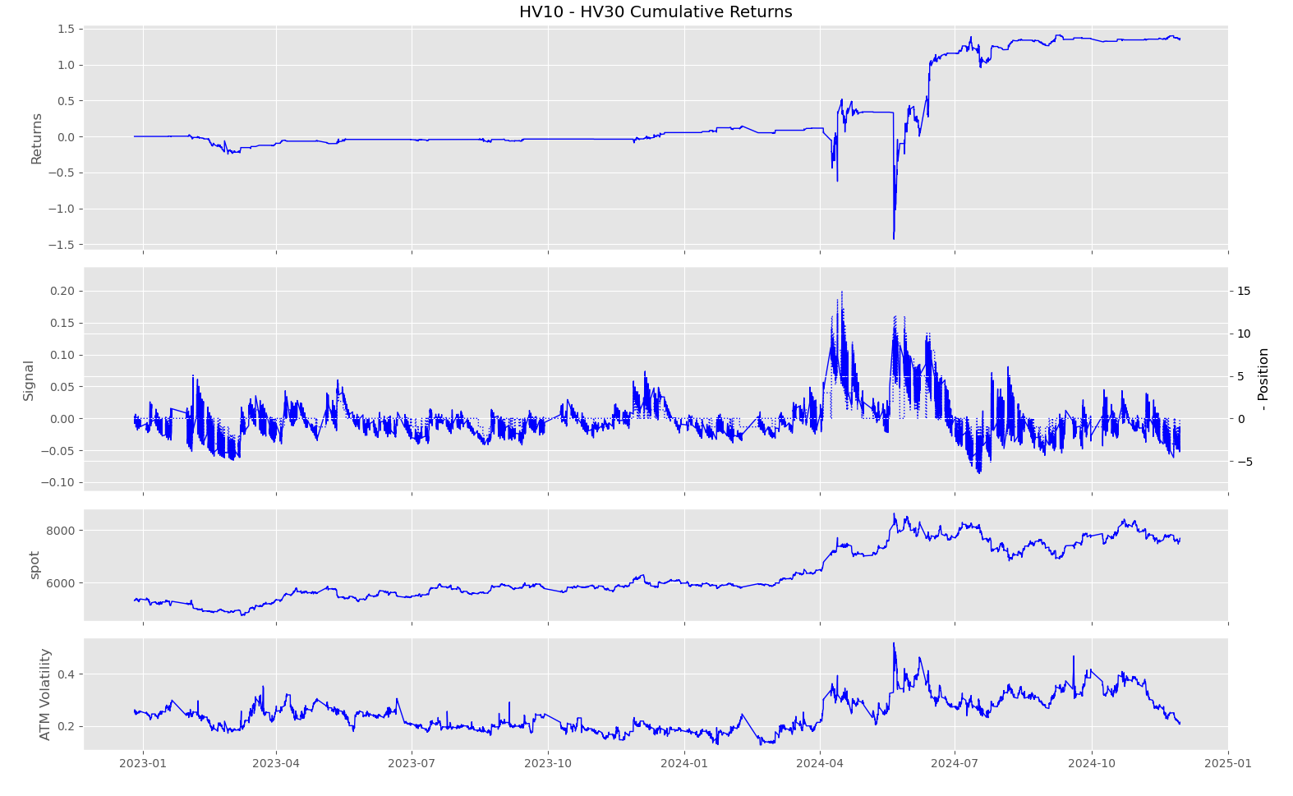
HV10 – HV30
frequency = 60min
alpha = 2
step = 0.01
max drawdown = -1.9488

Slide 20
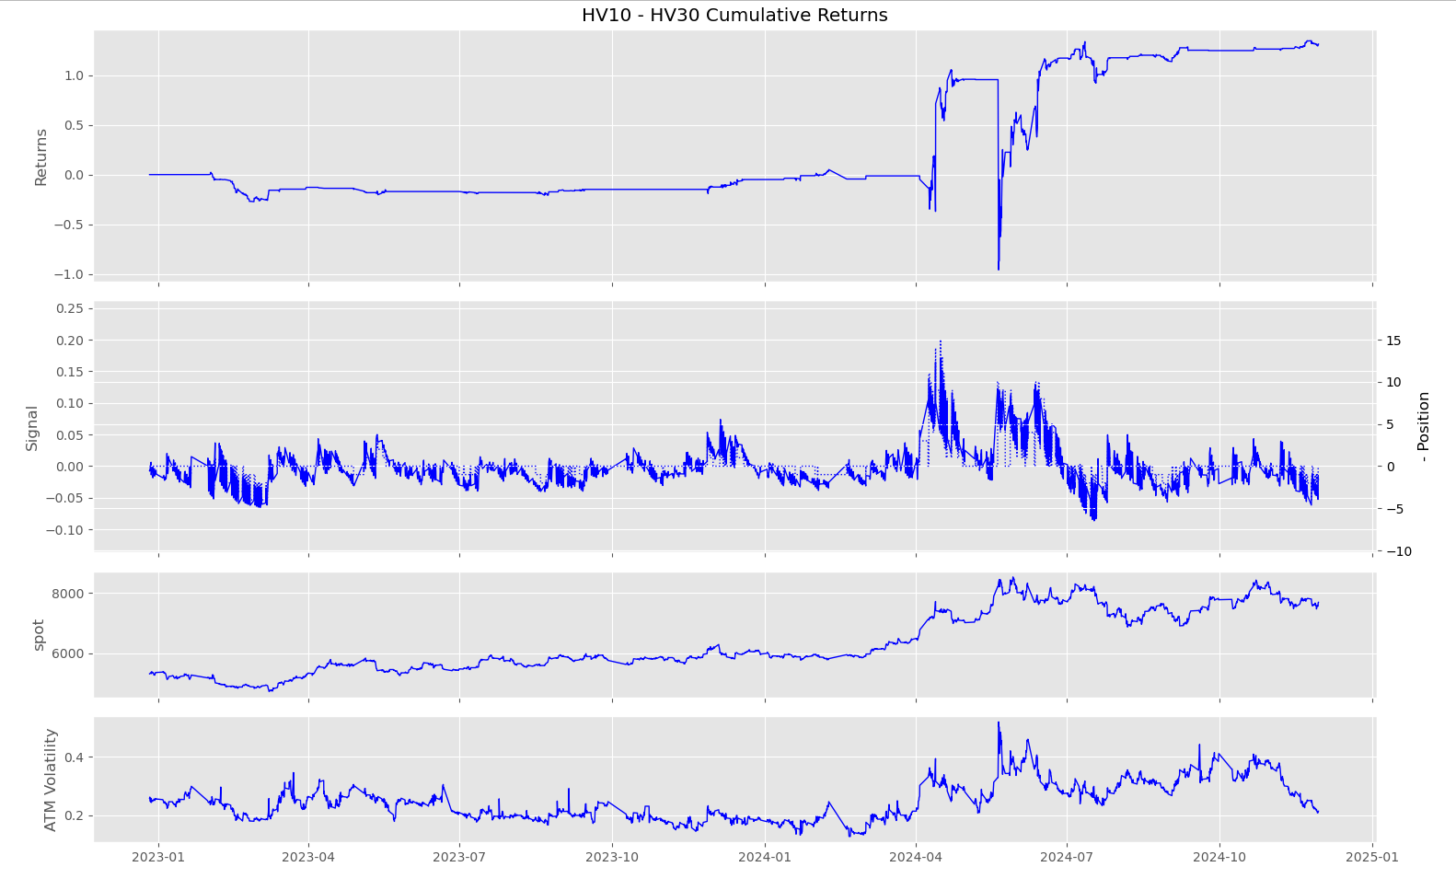
HV10 – HV30
frequency = 120min
alpha = 2
step = 0.01
max drawdown = -2.0148

Slide 21
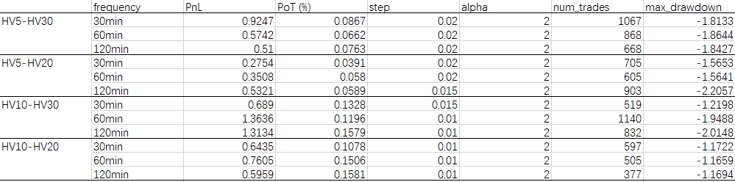
Analysis– Ag

Slide 22
Cu

Slide 23
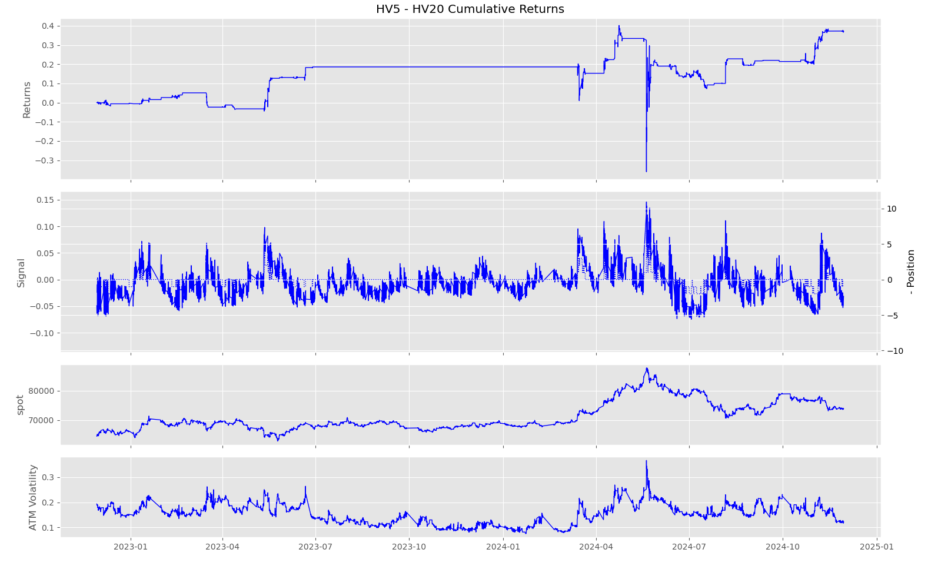
HV5 – HV20
frequency = 30min
alpha = 2
step = 0.015
max drawdown = -0.7622

Slide 24
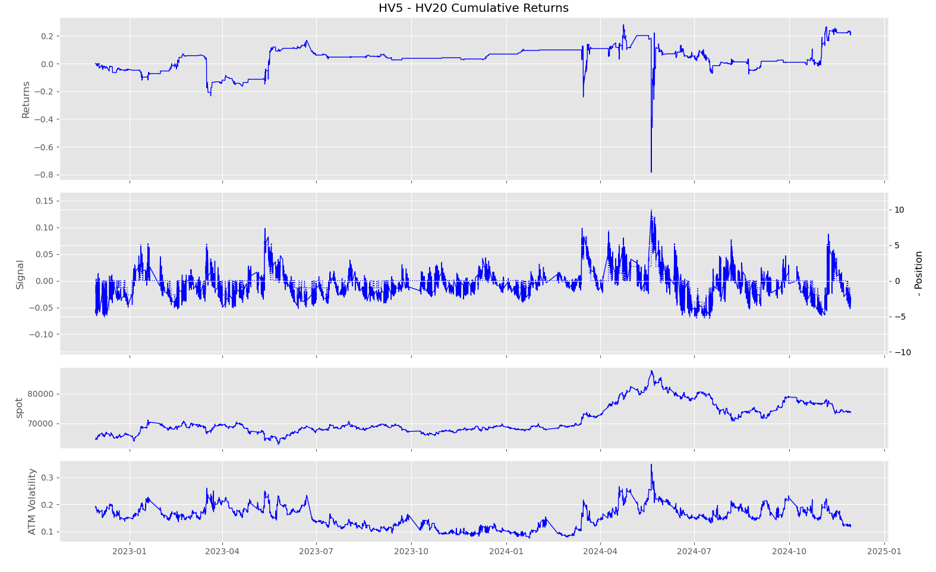
HV5 – HV20
frequency = 60min
alpha = 2
step = 0.01
max drawdown =
-1.0674

Slide 25
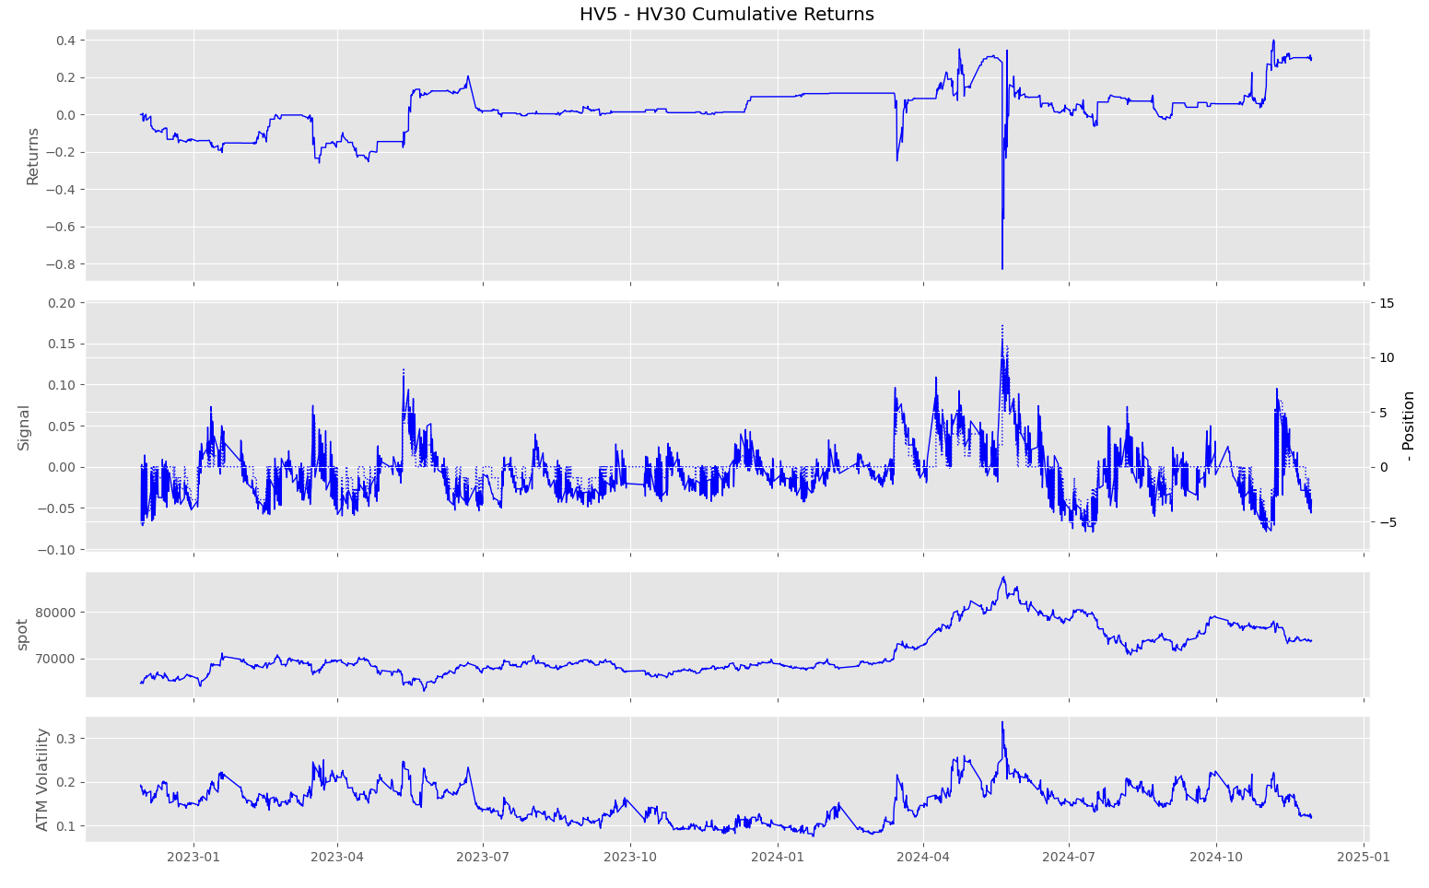
HV5 – HV20
frequency = 120min
alpha = 2
step = 0.01
max drawdown =
-0.8975

Slide 26
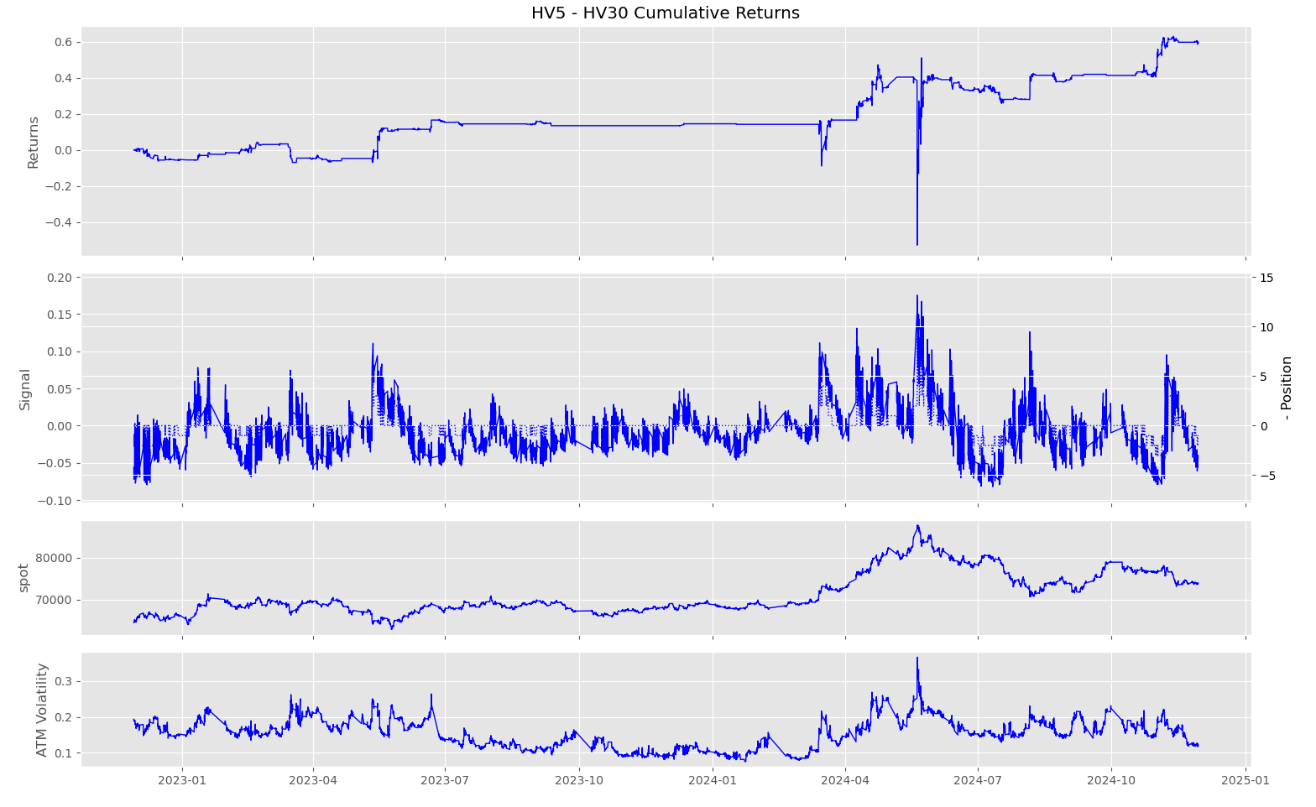
HV5 – HV30
frequency = 30min
alpha = 2
step = 0.015
max drawdown = -1.0017

Slide 27
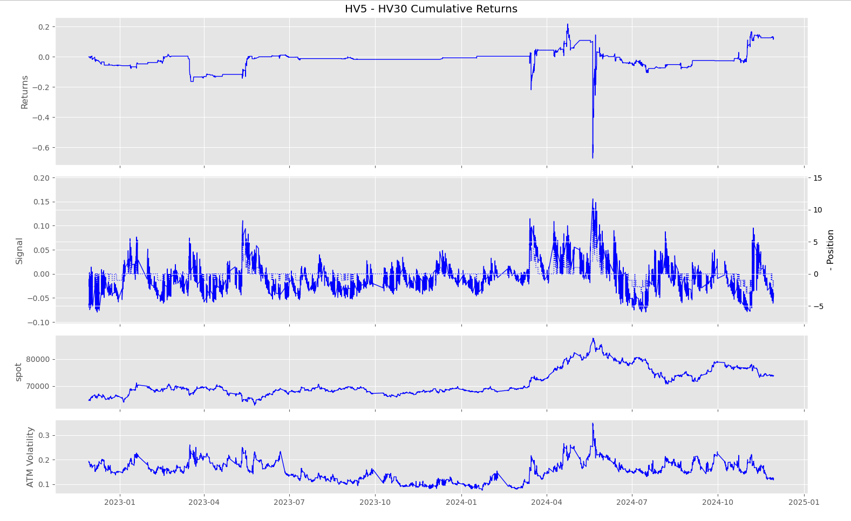
HV5 – HV30
frequency = 60min
alpha = 2
step = 0.015
max drawdown =
-0.8900

Slide 28
HV5 – HV30
frequency = 120min
alpha = 2
step = 0.01
max drawdown =
-1.1831

Slide 29
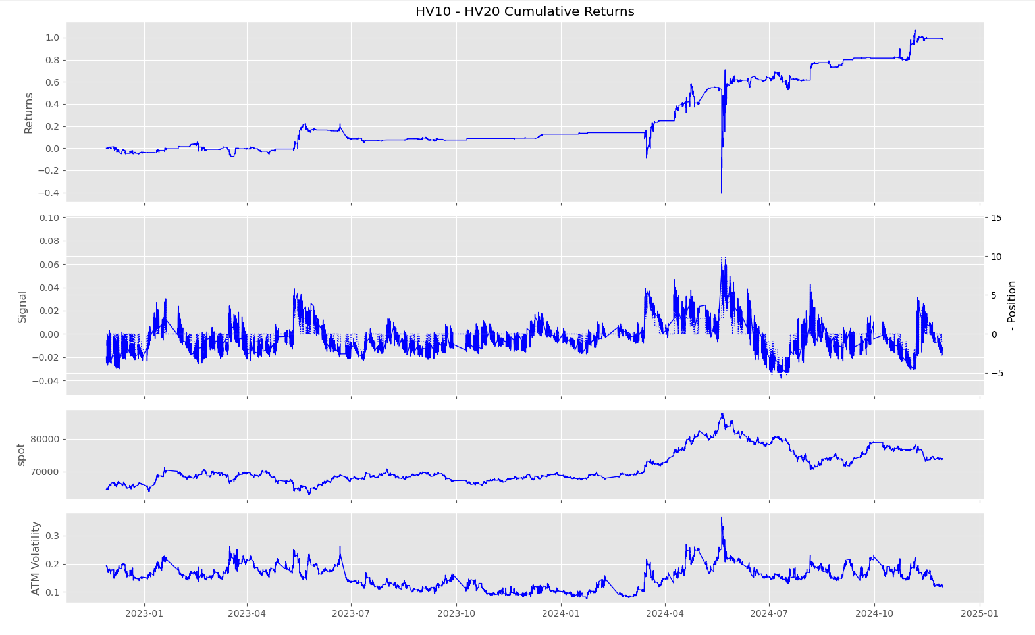
HV10 – HV20
frequency = 30min
alpha = 2
step = 0.005
max drawdown = -1.1722

Slide 30
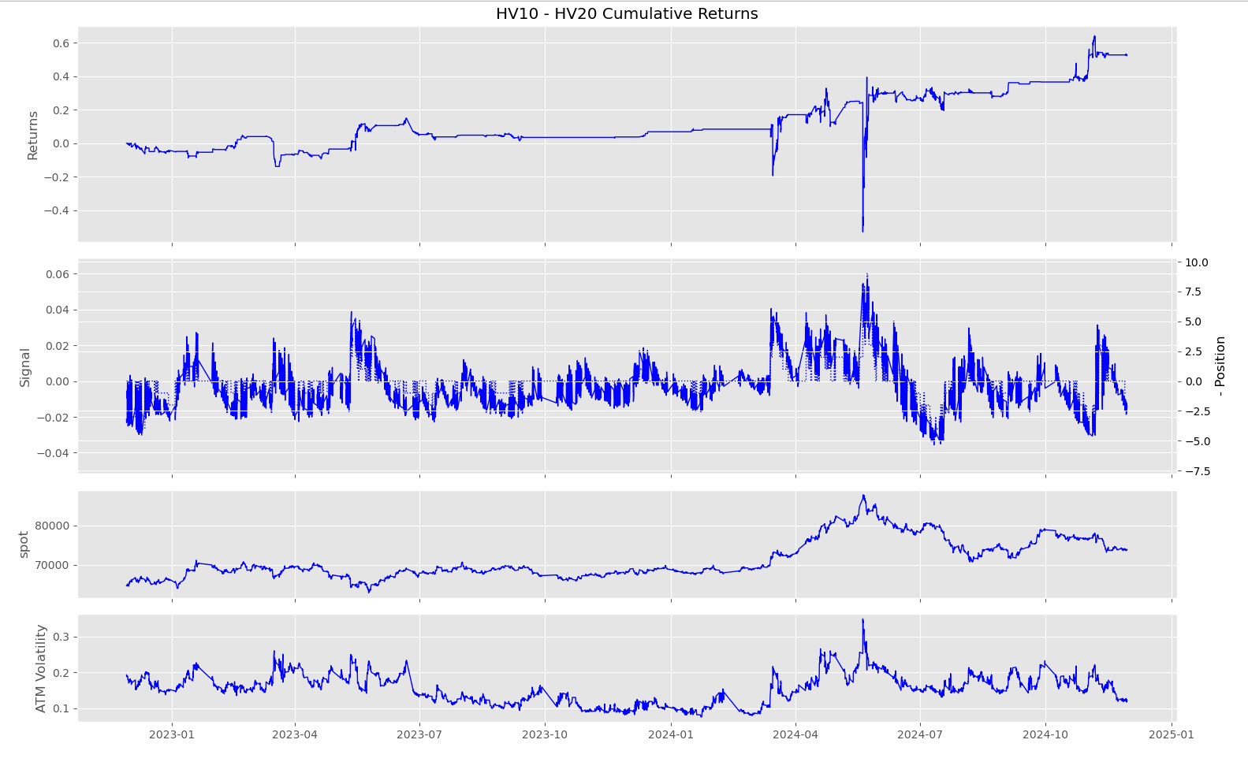
HV10 – HV20
frequency = 60min
alpha = 2
step = 0.005
max drawdown = -0.8586

Slide 31
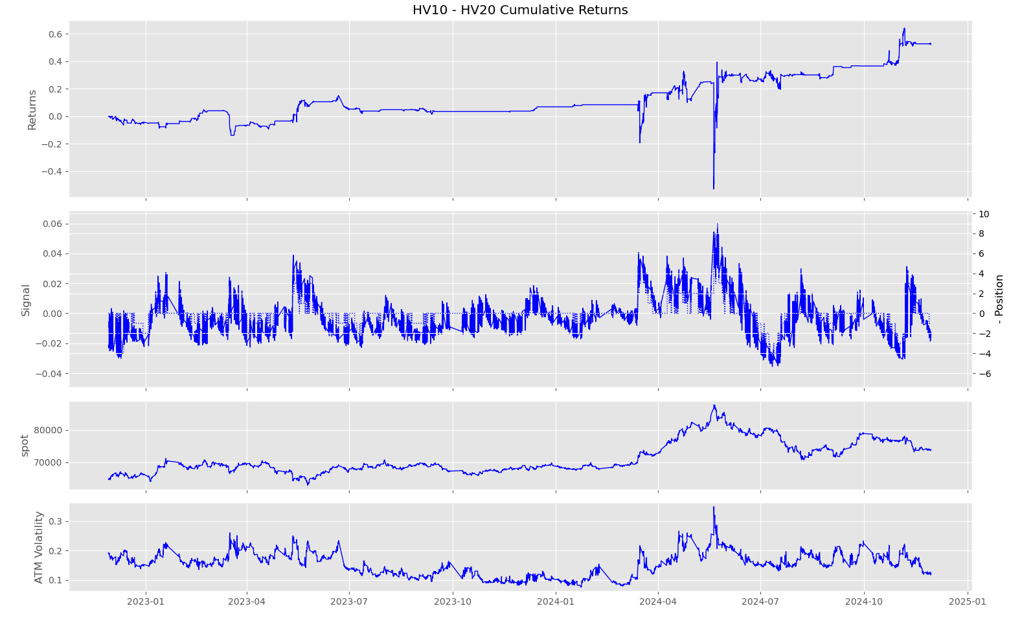
HV10 – HV20
frequency = 120min
alpha = 2
step = 0.005
max drawdown = -0.8586

Slide 32
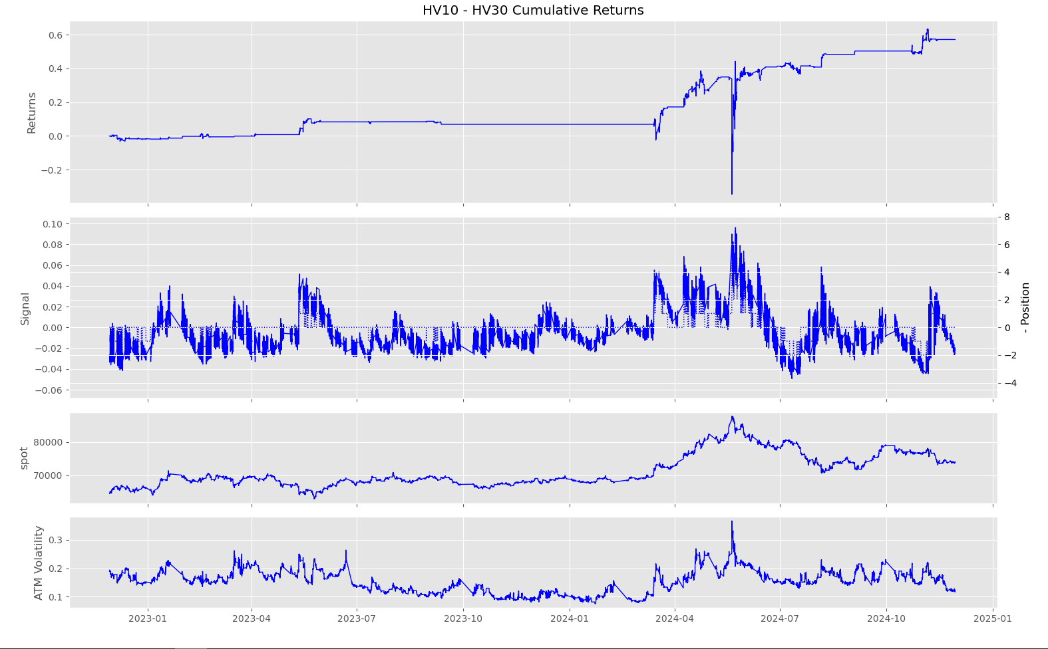
HV10 – HV30
frequency = 30min
alpha = 2
step = 0.01
max drawdown = -0.7326

Slide 33
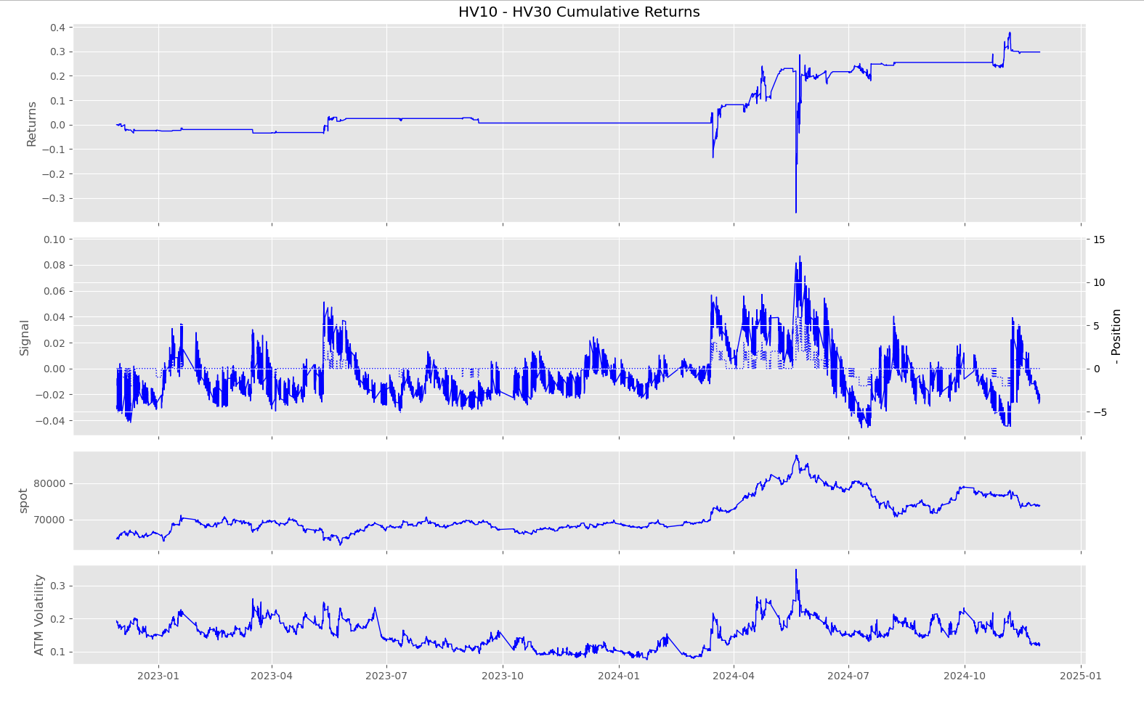
HV10 – HV30
frequency = 60min
alpha = 2
step = 0.01
max drawdown = -0.6007

Slide 34
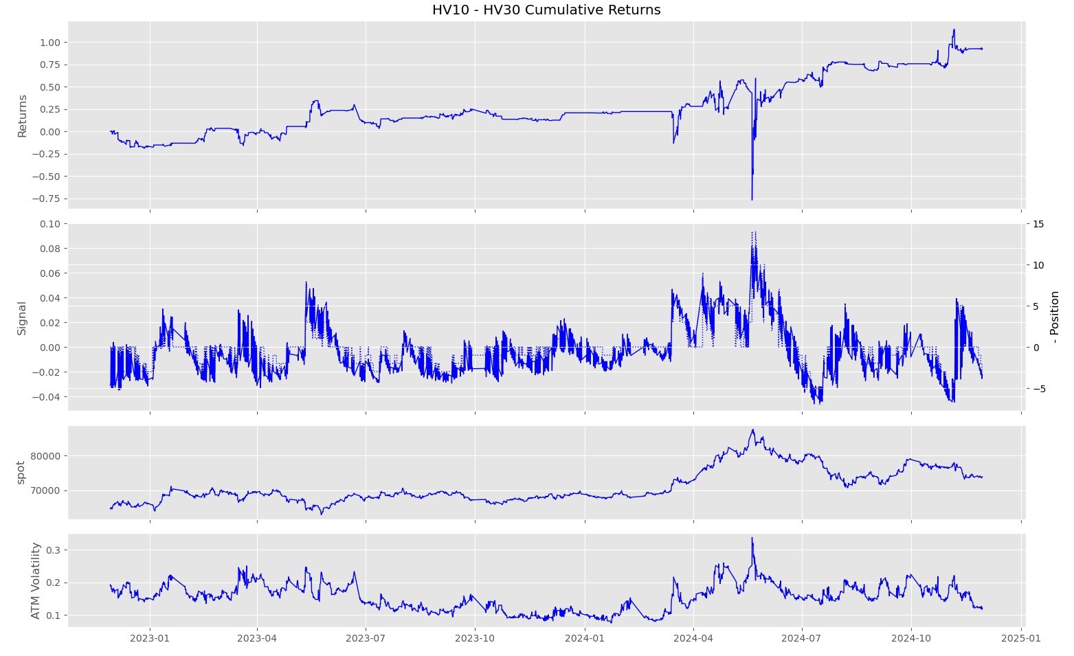
HV10 – HV30
frequency = 120min
alpha = 2
step = 0.005
max drawdown = -2.0148

Slide 35
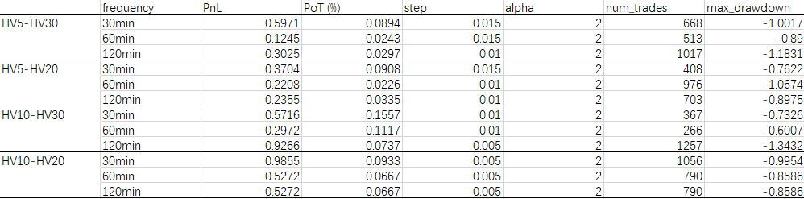
Analysis– Cu

Slide 36
I

Slide 37
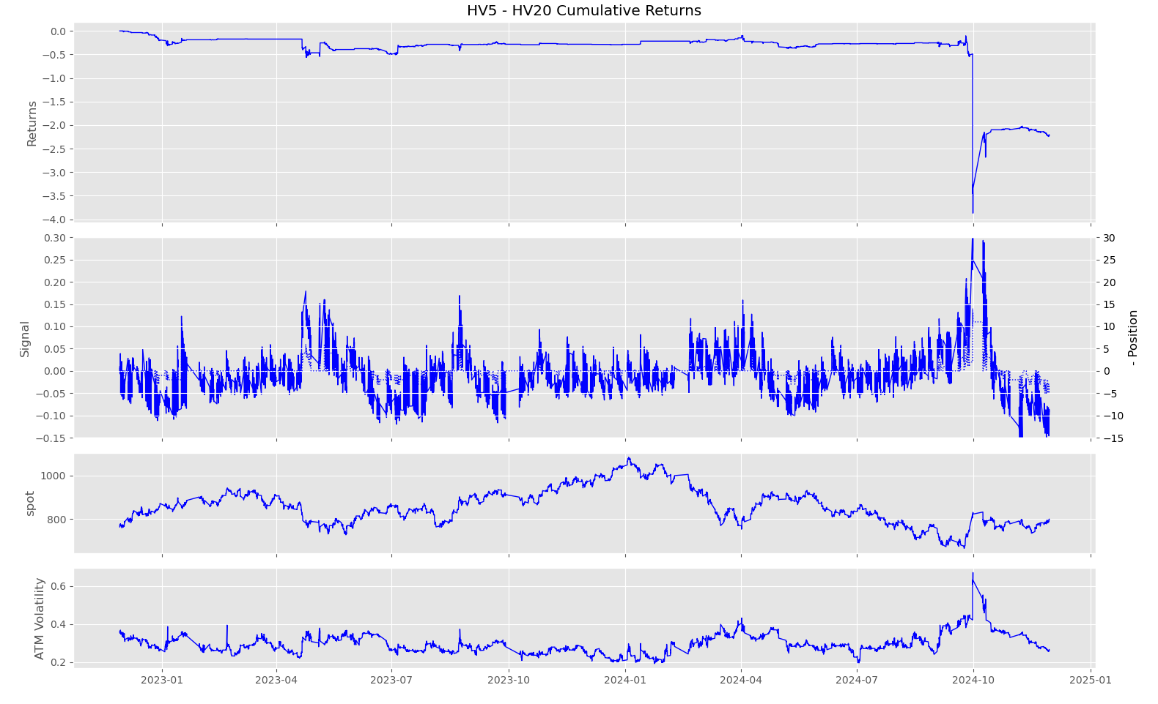
HV5 – HV20
frequency = 30min
alpha = 2
step = 0.02
max drawdown = -3.8705

Slide 38
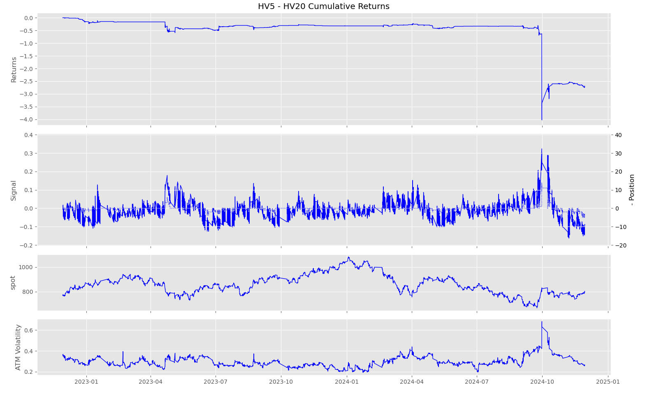
HV5 – HV20
frequency = 60min
alpha = 2
step = 0.02
max drawdown =
-4.0237

Slide 39
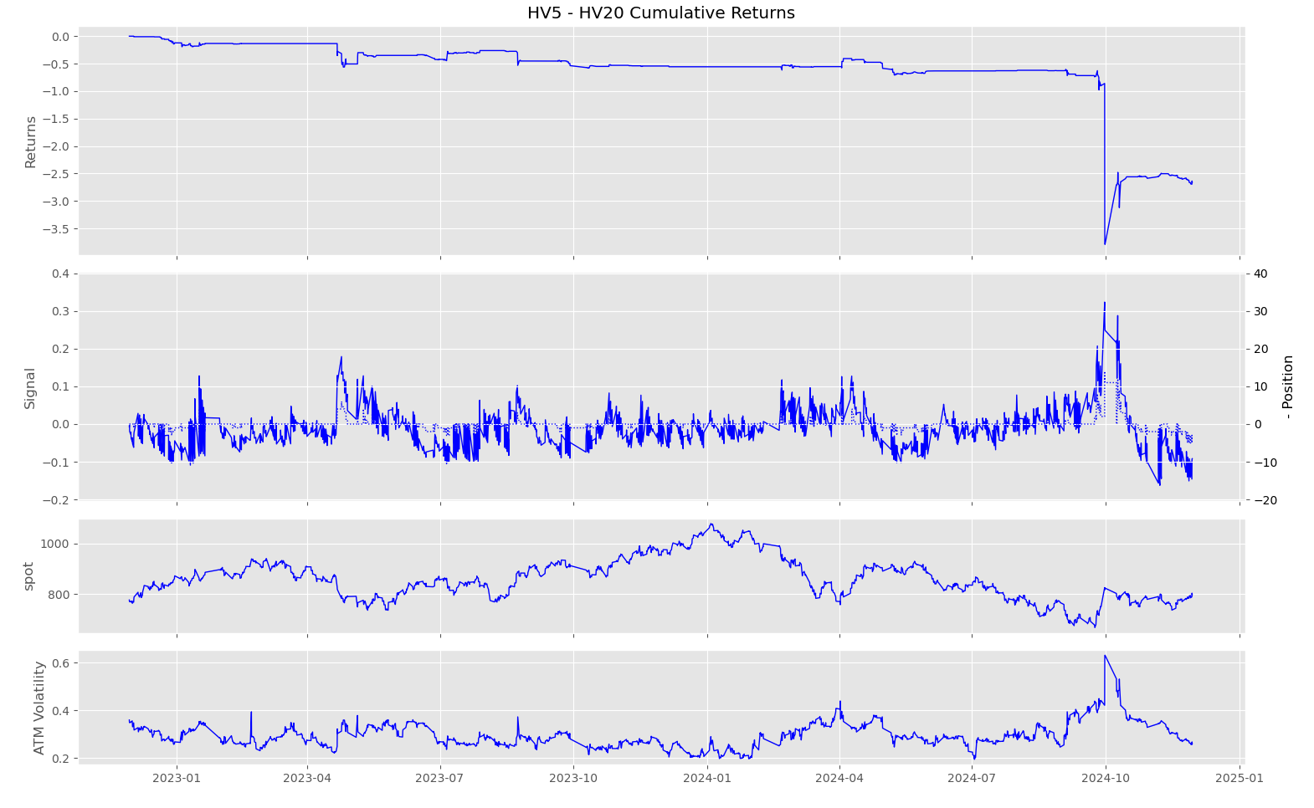
HV5 – HV20
frequency = 120min
alpha = 2
step = 0.02
max drawdown =
-3.7909

Slide 40
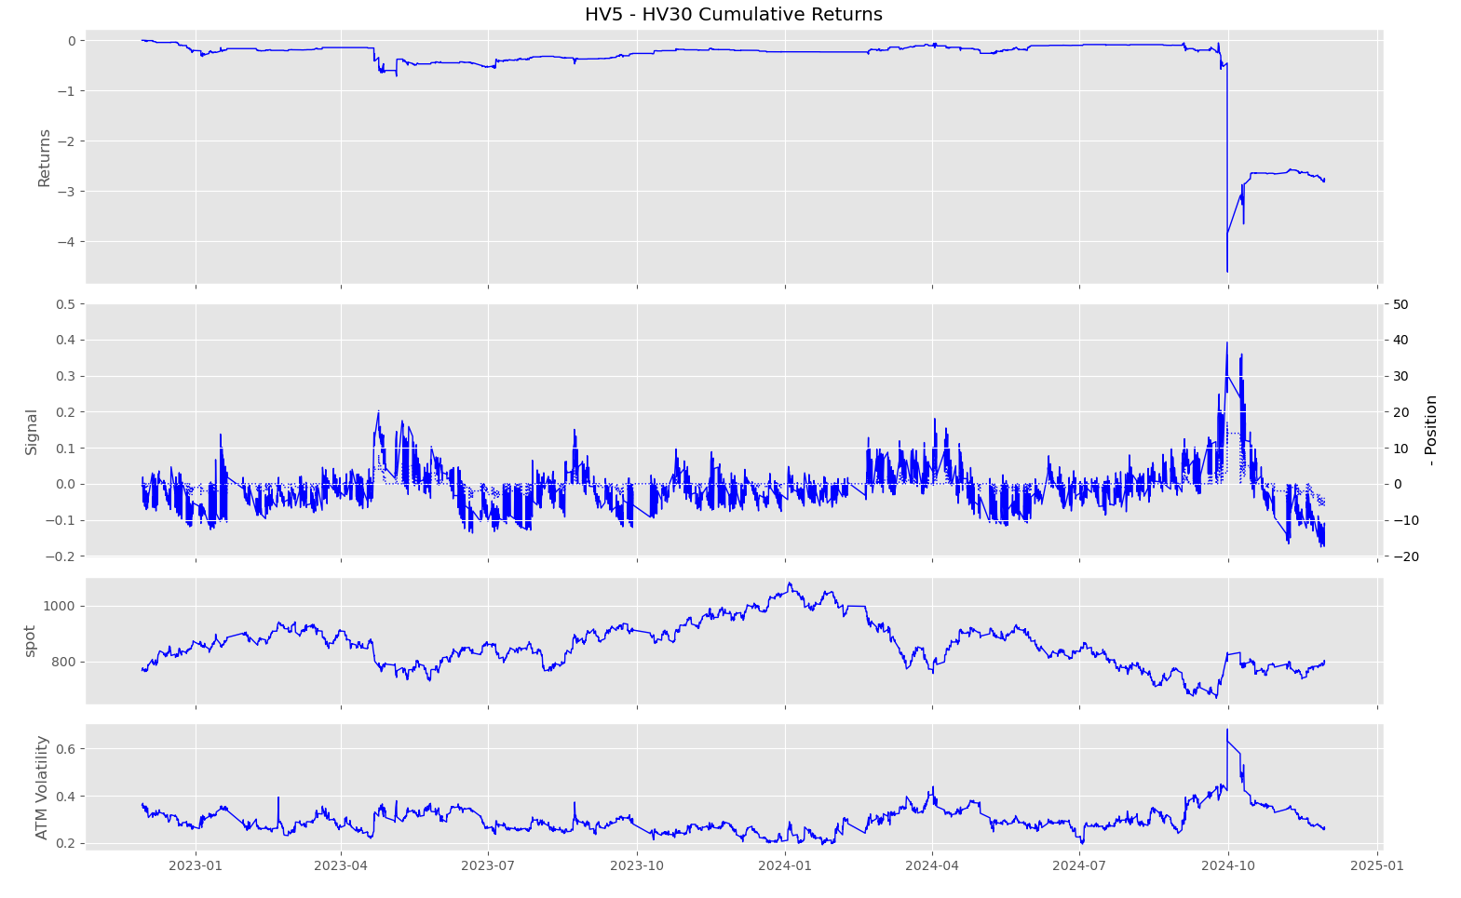
HV5 – HV30
frequency = 30min
alpha = 2
step = 0.02
max drawdown =
-3.5036

Slide 41
HV5 – HV30
frequency = 60min
alpha = 2
step = 0.02
max drawdown =
-4.6130

Slide 42
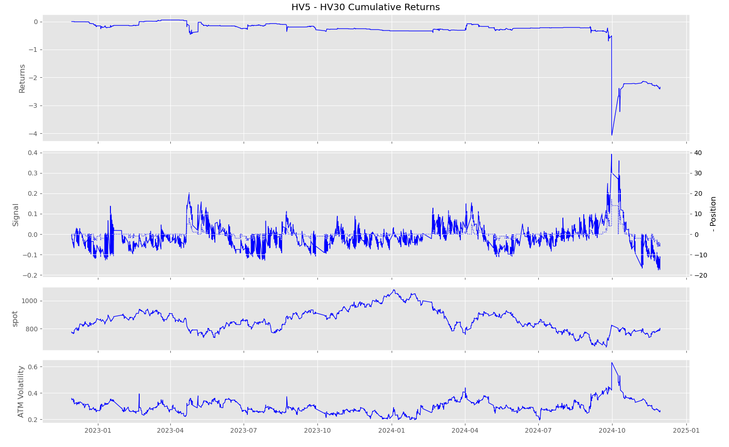
HV5 – HV30
frequency = 120min
alpha = 2
step = 0.02
max drawdown =
-4.1240

Slide 43
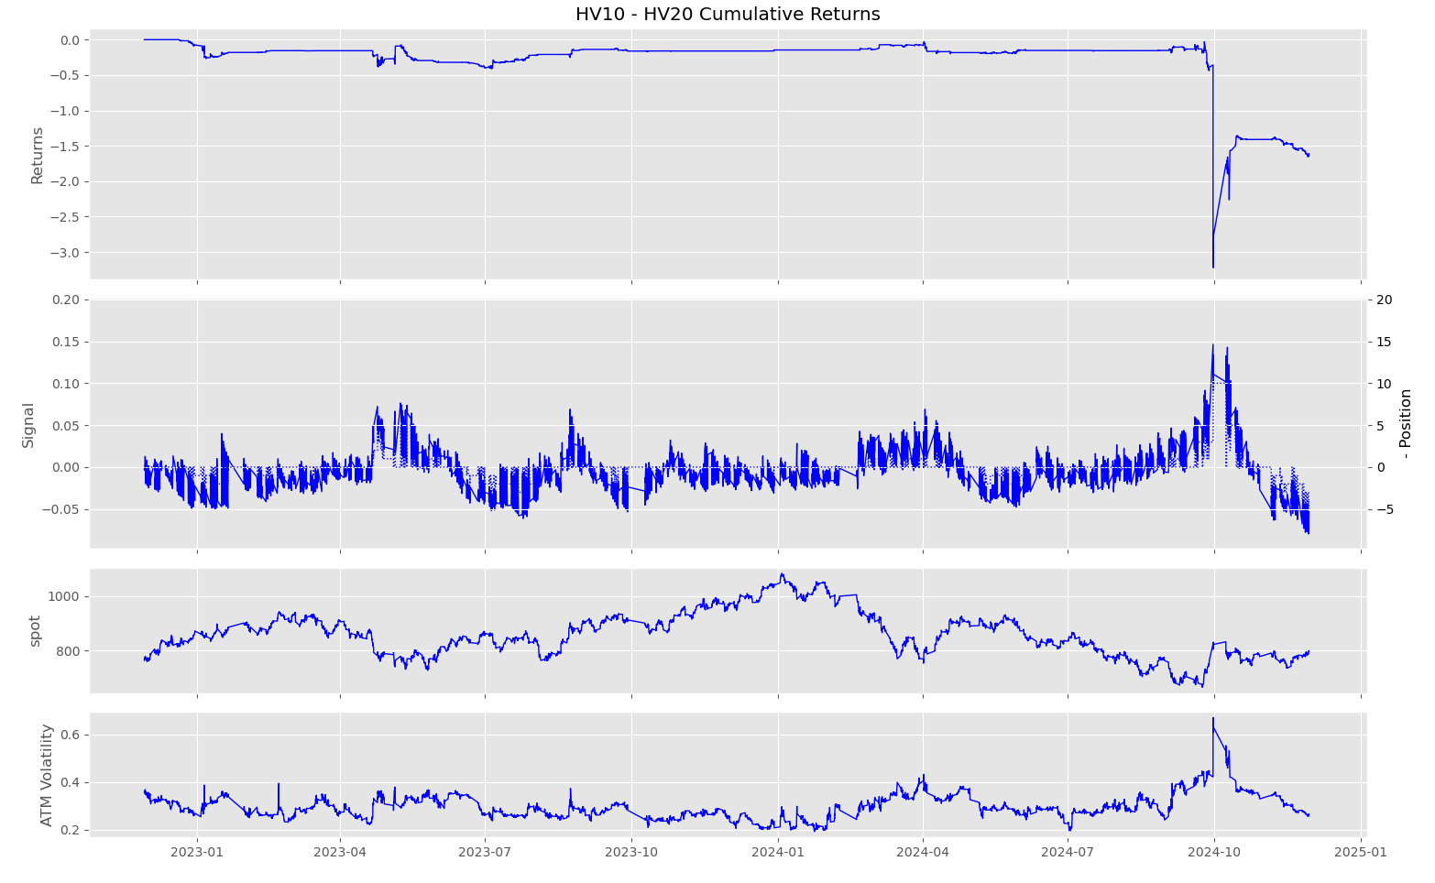
HV10 – HV20
frequency = 30min
alpha = 2
step = 0.01
max drawdown =
-3.2224

Slide 44
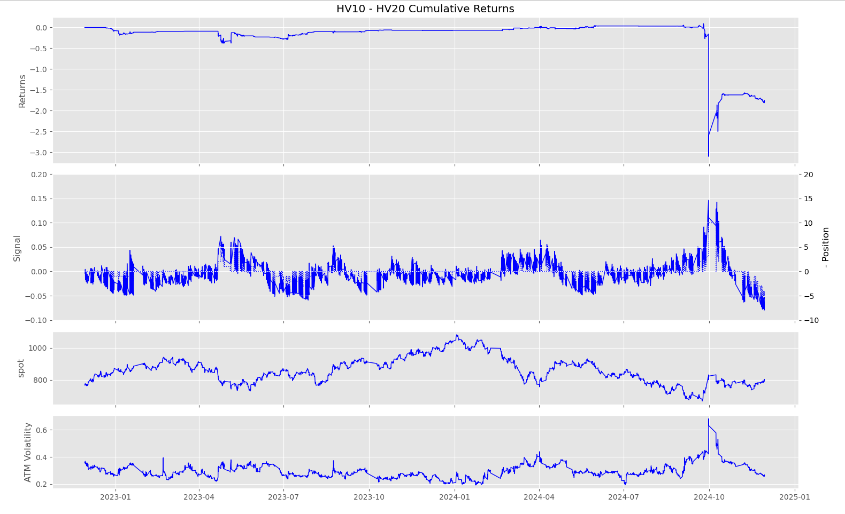
HV10 – HV20
frequency = 60min
alpha = 2
step = 0.01
max drawdown =
-3.1963

Slide 45
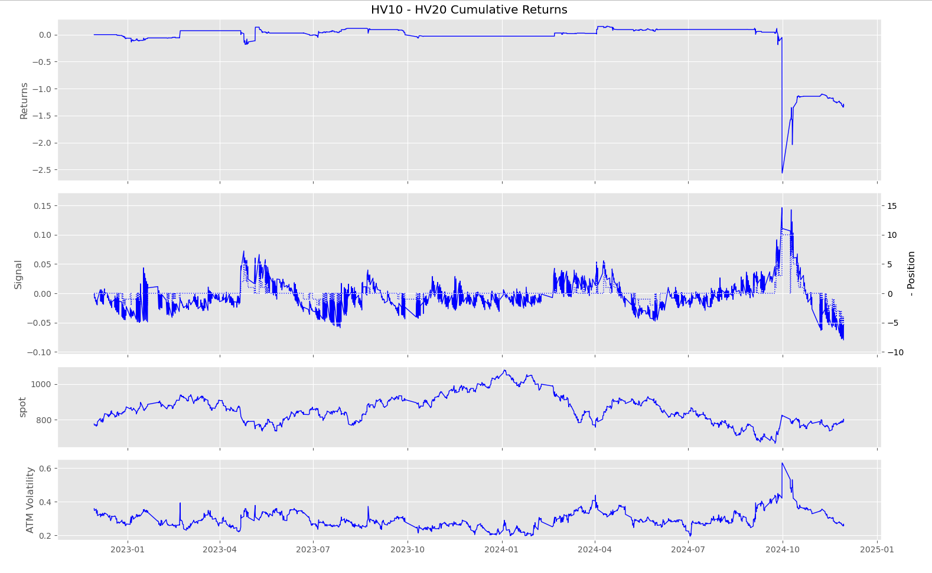
HV10 – HV20
frequency = 120min
alpha = 2
step = 0.01
max drawdown = -2.7231

Slide 46
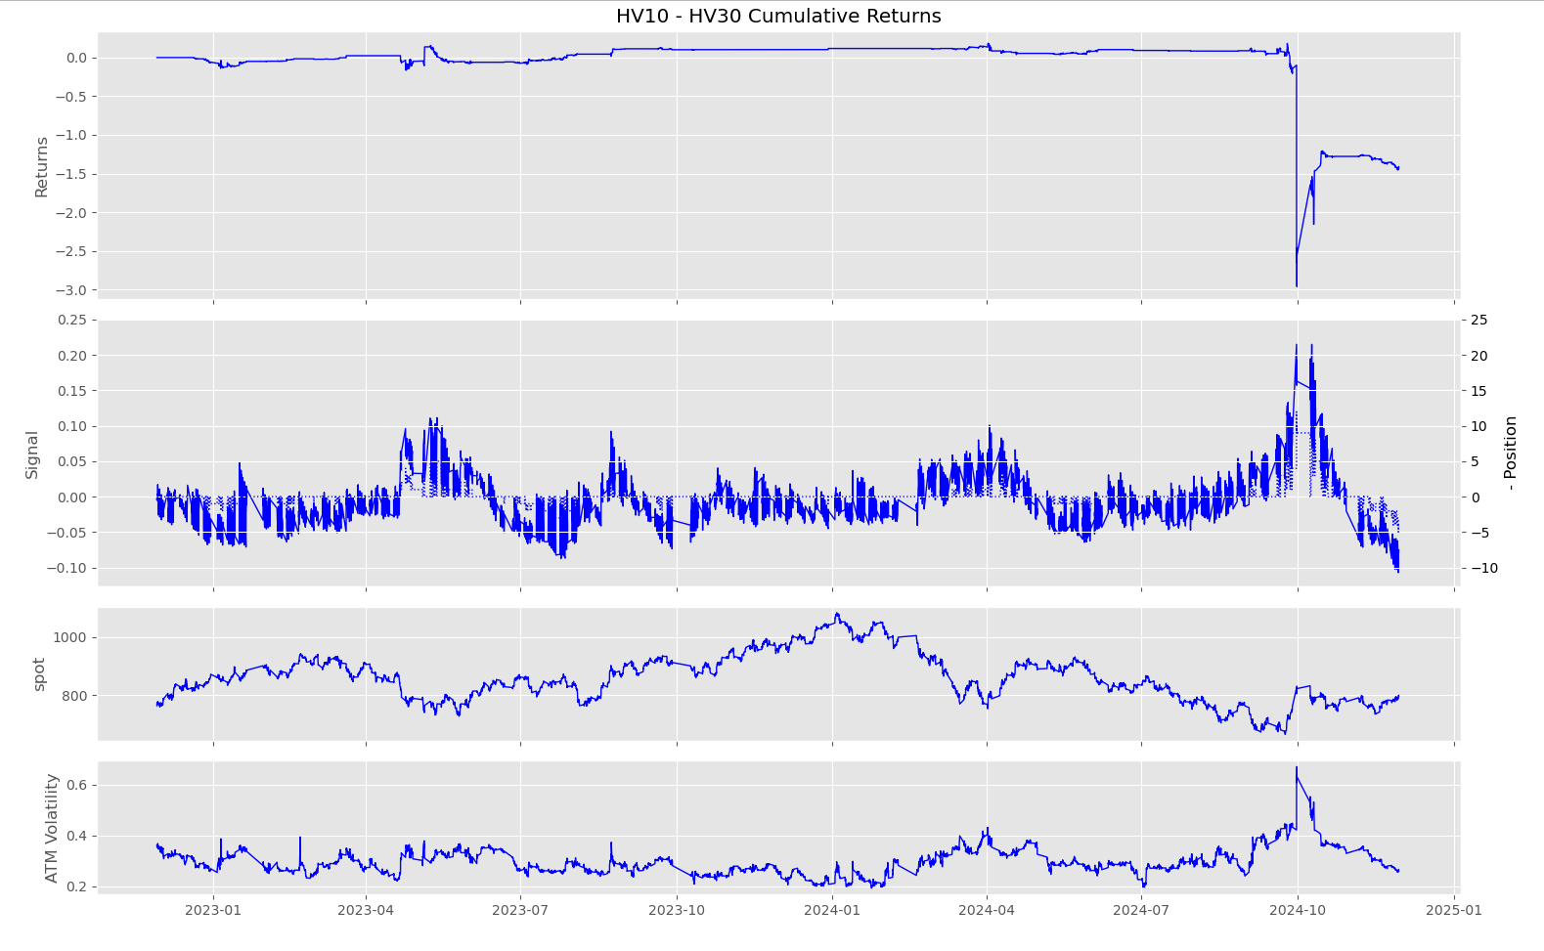
HV10 – HV30
frequency = 30min
alpha = 2
step = 0.015
max drawdown = -3.1485

Slide 47
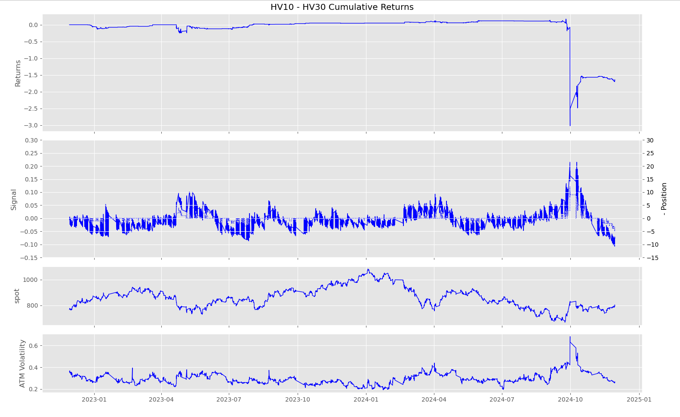
HV10 – HV30
frequency = 60min
alpha = 2
step = 0.015
max drawdown = -3.1933

Slide 48
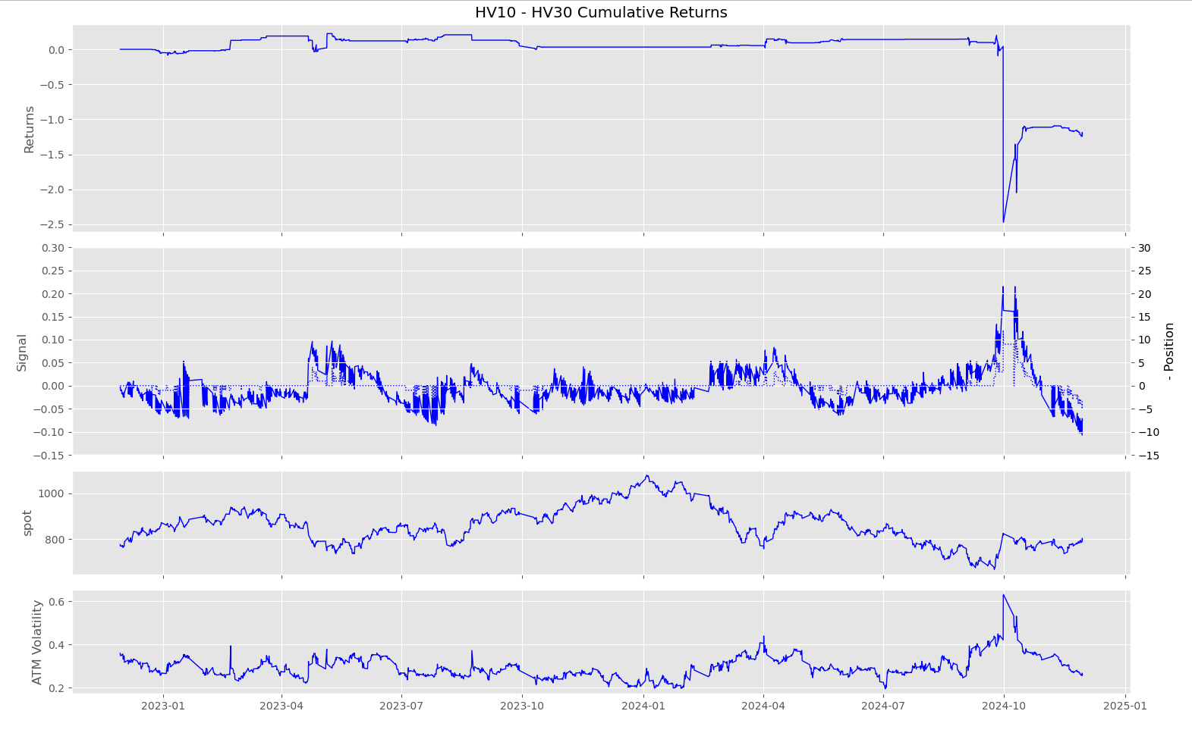
HV10 – HV30
frequency = 120min
alpha = 2
step = 0.015
max drawdown = -2.6967

Slide 49
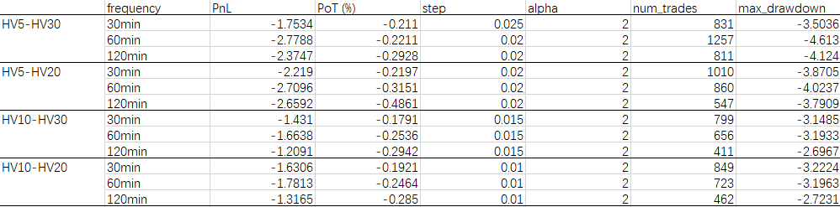
Analysis– I

Slide 50
M

Slide 51
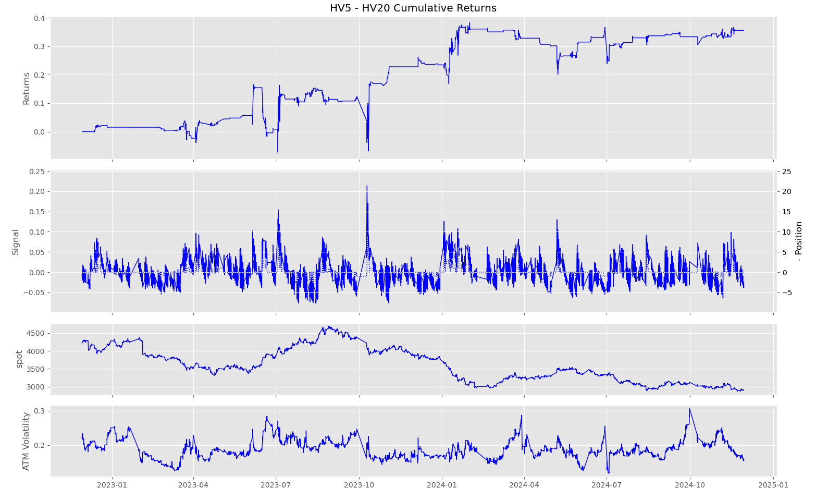
HV5 – HV20
frequency = 30min
alpha = 2
step = 0.015
max drawdown = -0.2381

Slide 52
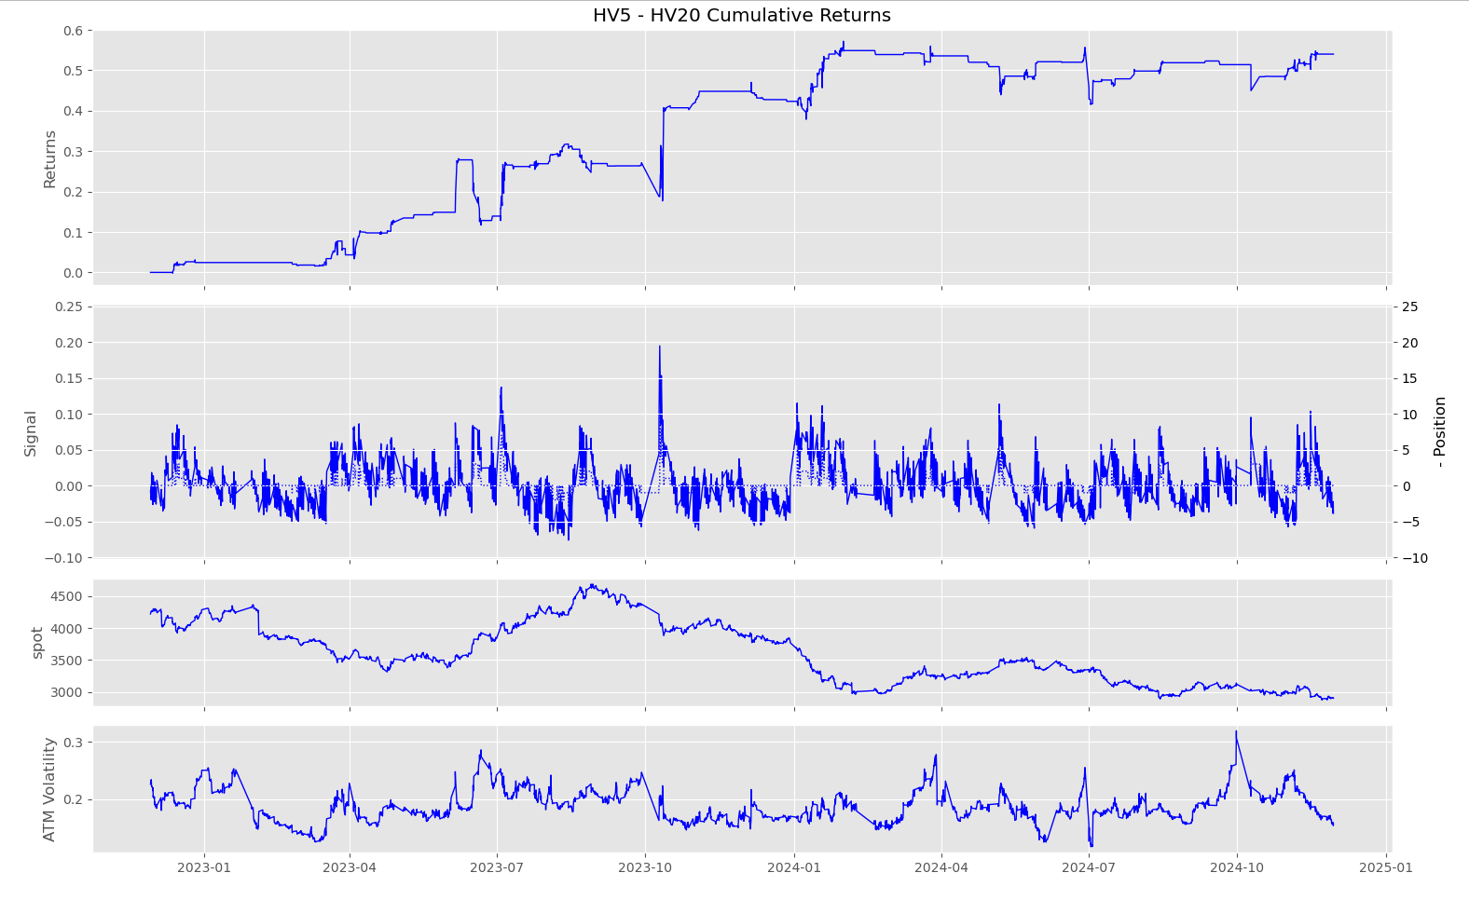
HV5 – HV20
frequency = 60min
alpha = 2
step = 0.015
max drawdown =
-0.1645

Slide 53
HV5 – HV20
frequency = 120min
alpha = 2
step = 0.015
max drawdown =
-0.1385

Slide 54
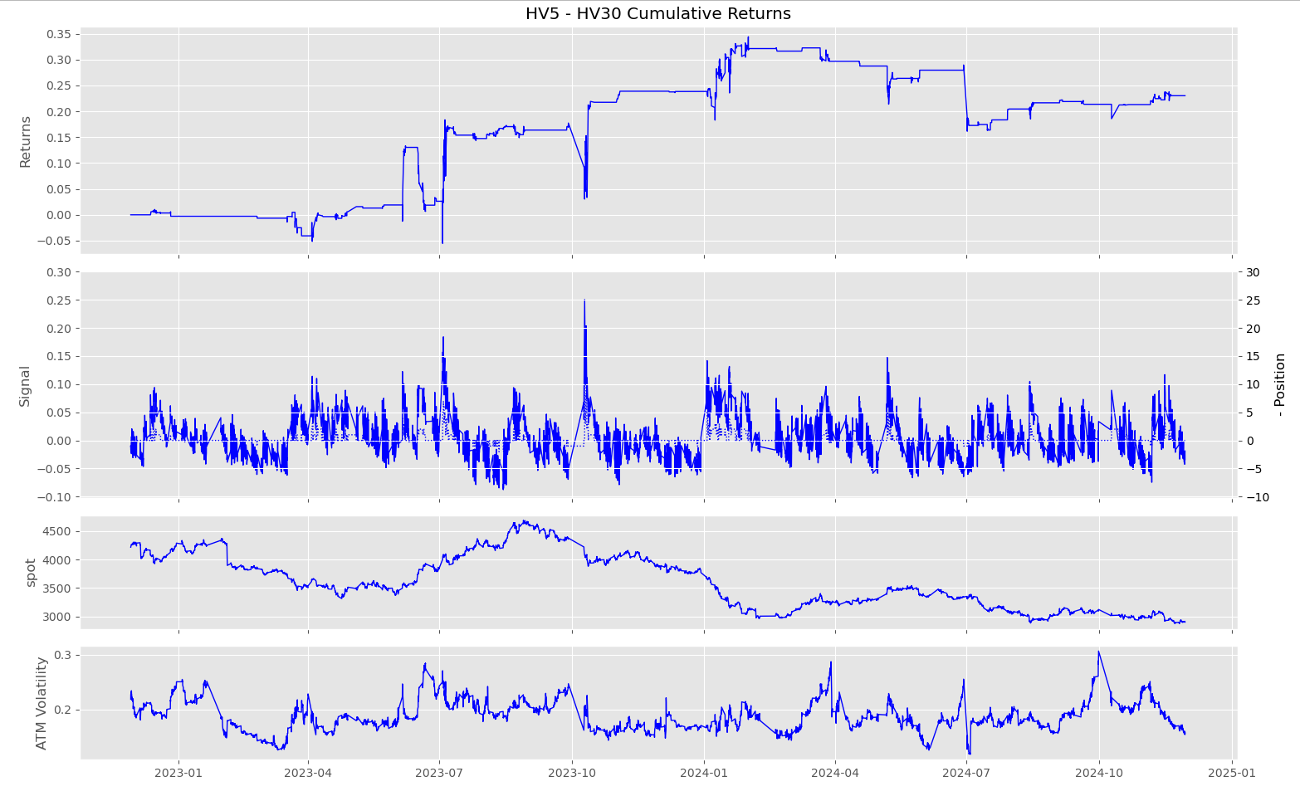
HV5 – HV30
frequency = 30min
alpha = 2
step = 0.02
max drawdown =
-0.1886

Slide 55
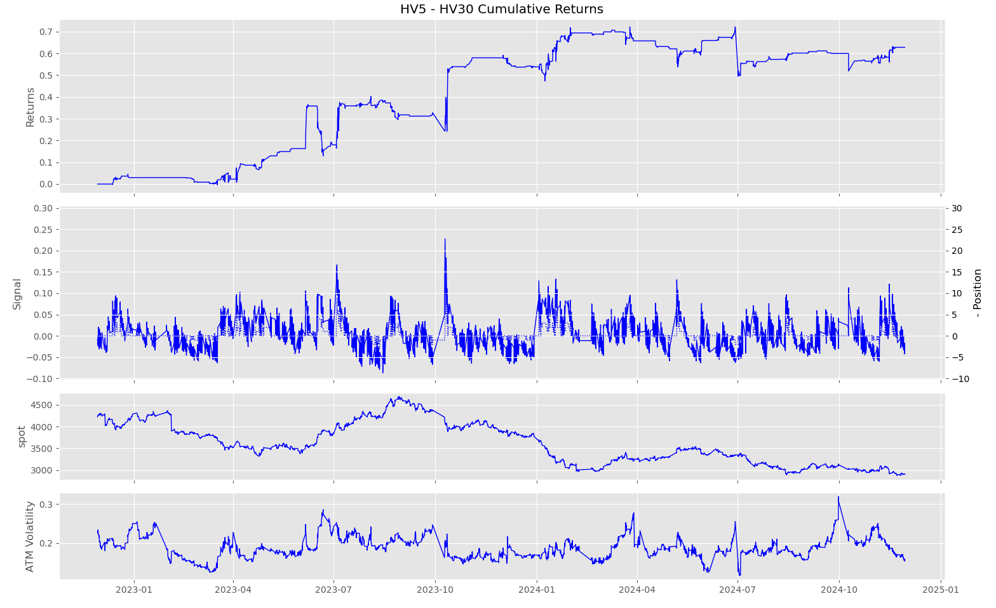
HV5 – HV30
frequency = 60min
alpha = 2
step = 0.015
max drawdown =
-0.2359

Slide 56
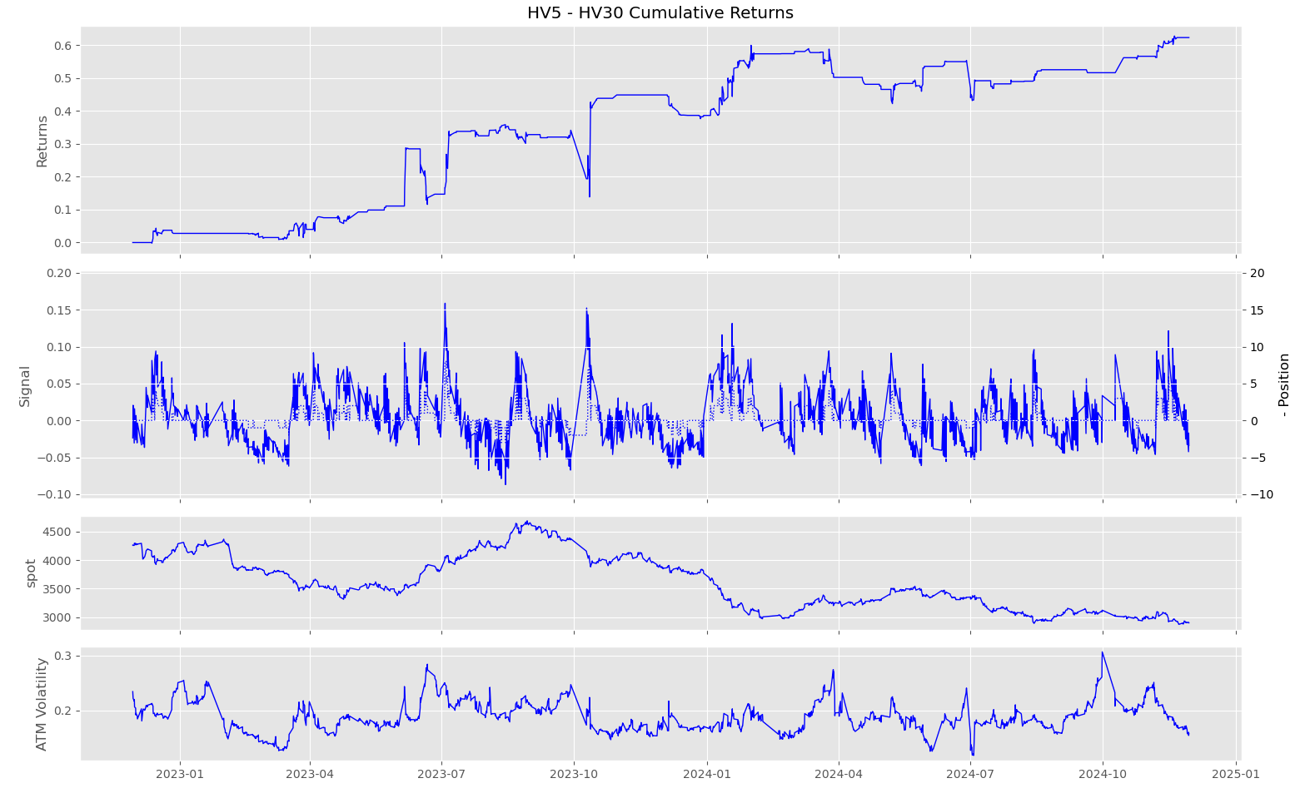
HV5 – HV30
frequency = 120min
alpha = 2
step = 0.015
max drawdown =
-0.2197

Slide 57
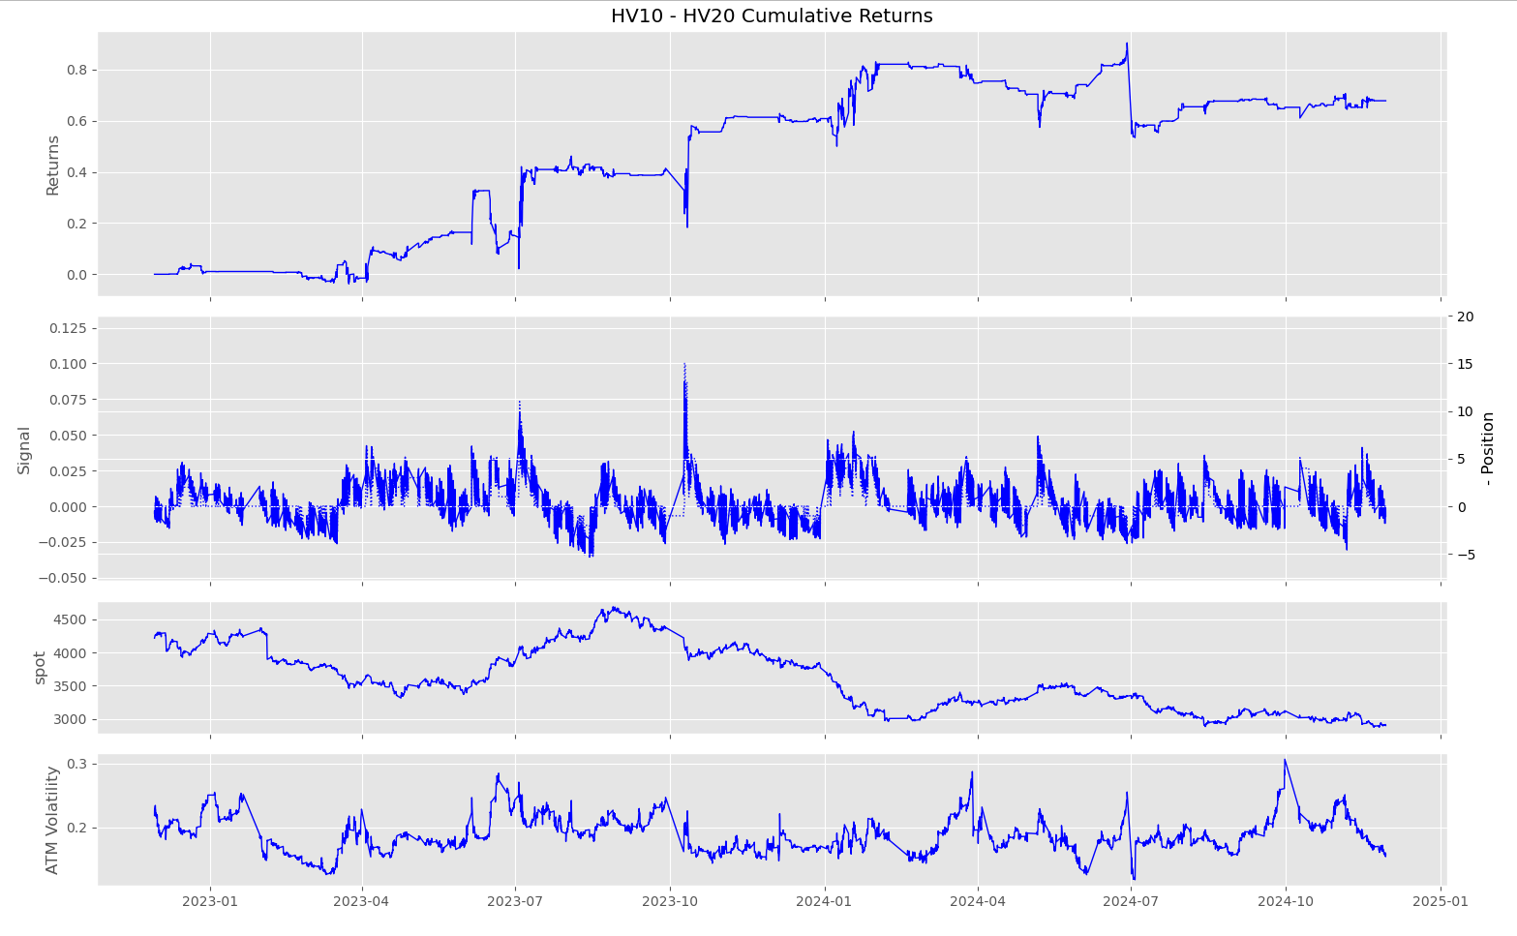
HV10 – HV20
frequency = 30min
alpha = 2
step = 0.005
max drawdown =
-0.3704

Slide 58
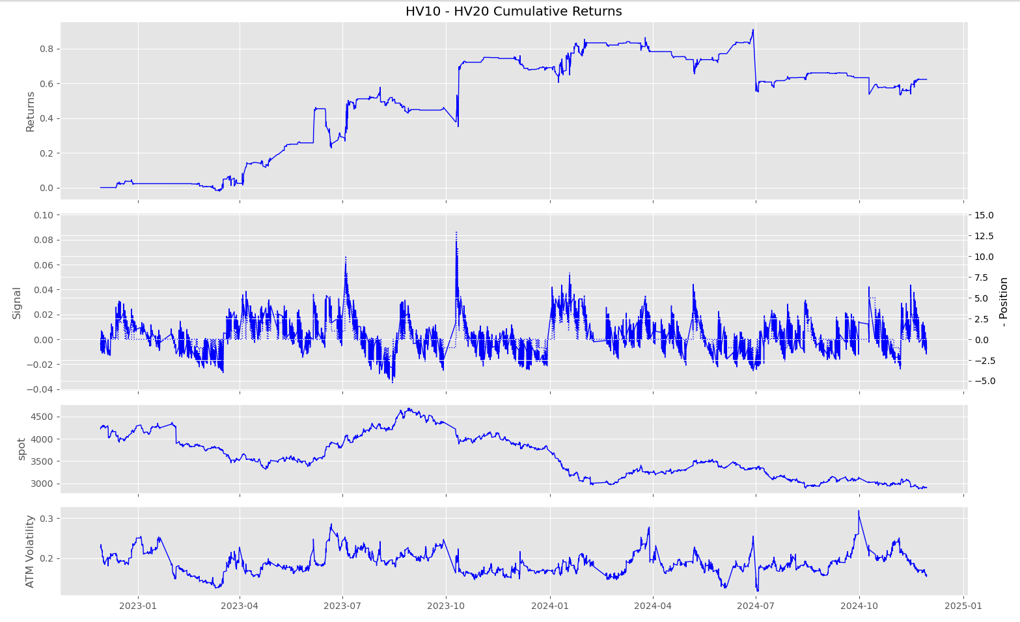
HV10 – HV20
frequency = 60min
alpha = 2
step = 0.005
max drawdown =
-0.3768

Slide 59

HV10 – HV20
frequency = 120min
alpha = 2
step = 0.005
max drawdown = -0.2983

Slide 60
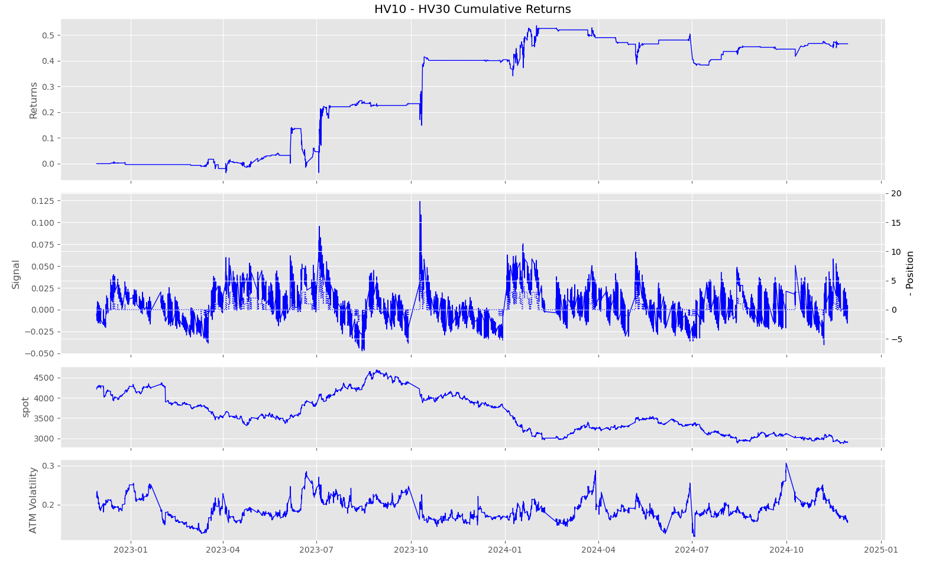
HV10 – HV30
frequency = 30min
alpha = 2
step = 0.01
max drawdown = -0.1760

Slide 61

HV10 – HV30
frequency = 60min
alpha = 2
step = 0.01
max drawdown = -0.2082

Slide 62

HV10 – HV30
frequency = 120min
alpha = 2
step = 0.01
max drawdown = -0.1021

Slide 63

Analysis – M

Slide 64
Sc

Slide 65

HV5 – HV20
frequency = 30min
alpha = 2
step = 0.02
max drawdown = -1.0431

Slide 66

HV5 – HV20
frequency = 60min
alpha = 2
step = 0.02
max drawdown =
-0.8110

Slide 67

HV5 – HV20
frequency = 120min
alpha = 2
step = 0.02
max drawdown =
-0.7684

Slide 68

HV5 – HV30
frequency = 30min
alpha = 2
step = 0.025
max drawdown =
-0.8720

Slide 69

HV5 – HV30
frequency = 60min
alpha = 2
step = 0.025
max drawdown =
-0.6312

Slide 70

HV5 – HV30
frequency = 120min
alpha = 2
step = 0.025
max drawdown =
-0.5637

Slide 71

HV10 – HV20
frequency = 30min
alpha = 2
step = 0.01
max drawdown =
-0.8094

Slide 72

HV10 – HV20
frequency = 60min
alpha = 2
step = 0.01
max drawdown =
-0.5927

Slide 73

HV10 – HV20
frequency = 120min
alpha = 2
step = 0.01
max drawdown = -0.6007

Slide 74

HV10 – HV30
frequency = 30min
alpha = 2
step = 0.015
max drawdown = -0.5909

Slide 75

HV10 – HV30
frequency = 60min
alpha = 2
step = 0.015
max drawdown = -0.5347

Slide 76

HV10 – HV30
frequency = 120min
alpha = 2
step = 0.01
max drawdown = -0.7914

Slide 77

Analysis– Sc

Slide 78
Sa

Slide 79

HV5 – HV20
frequency = 30min
alpha = 2
step = 0.025
max drawdown = -2.4027

Slide 80

HV5 – HV20
frequency = 60min
alpha = 2
step = 0.02
max drawdown =
-2.6268

Slide 81

HV5 – HV20
frequency = 120min
alpha = 2
step = 0.02
max drawdown =
-2.2641

Slide 82

HV5 – HV30
frequency = 30min
alpha = 2
step = 0.03
max drawdown =
-2.0749

Slide 83

HV5 – HV30
frequency = 60min
alpha = 2
step = 0.03
max drawdown =
-1.4498

Slide 84

HV5 – HV30
frequency = 120min
alpha = 2
step = 0.025
max drawdown =
-1.6103

Slide 85

HV10 – HV20
frequency = 30min
alpha = 2
step = 0.015
max drawdown =
-1.0609

Slide 86

HV10 – HV20
frequency = 60min
alpha = 2
step = 0.01
max drawdown =
-1.5819

Slide 87

HV10 – HV20
frequency = 120min
alpha = 2
step = 0.01
max drawdown = -1.1991

Slide 88

HV10 – HV30
frequency = 30min
alpha = 2
step = 0.015
max drawdown = -1.8102

Slide 89

HV10 – HV30
frequency = 60min
alpha = 2
step = 0.015
max drawdown = -1.14311

Slide 90

HV10 – HV30
frequency = 120min
alpha = 2
step = 0.01
max drawdown = -1.8902

Slide 91

Analysis– Sa

Slide 92
Overview
Profit and Loss (PnL)
Sa market (120 min): Highest average PnL, indicating better performance in a longer time frame.
I market (30 min): Lowest PnL, showing extreme instability over short periods, leading to heavy losses in trading strategies.
M and Sc markets: PnL is stable and performs well in time frames longer than 60 minutes.
2. Maximum Drawdown (Risk Assessment)
I market (60 min): Has the highest drawdown, indicating higher trading risks, especially in shorter time periods.
M market (120 min): Has the smallest drawdown, suggesting lower risk and suitability for stable trading strategies.
Sc and Cu markets: Have relatively low drawdowns across all time frames, demonstrating better risk control.
Overall Conclusion
Best markets: Sa (120 min) and M (120 min) are the best, with the highest PnL, moderate risk, and suitable trading frequency. Sc (60 min) is also stable and suitable for medium-frequency trading.
High-risk markets: I (30 min) performs the worst, with the lowest PnL and highest drawdowns, though it has frequent trades but suffers losses. Cu (60 min) has a lower PnL despite a higher trading frequency, requiring strategy optimization.
Optimal trading period: 120 minutes is the best time frame for most markets, providing higher PnL and more stable risk control. 30-minute intervals are better suited for active markets like Ag and Sa but may result in higher drawdowns.

Slide 93
Long Term Holding

Slide 94
Sc

Slide 95

HV5 – HV20
alpha = 2
step = 0.02
max drawdown = -0.4398

Slide 96

HV5 – HV30
alpha = 2
step = 0.02
max drawdown = -0.7908

Slide 97

HV10 – HV20
alpha = 2
step = 0.015
max drawdown = -0.1638

Slide 98

HV10 – HV30
alpha = 2
step = 0.02
max drawdown = -0.2109

Slide 99

Analysis– Sc

Slide 100
Sa

Slide 101

HV5 – HV20
alpha = 2
step = 0.02
max drawdown = -0.9946

Slide 102

HV5 – HV30
alpha = 2
step = 0.02
max drawdown = -1.4464

Slide 103

HV10 – HV20
alpha = 2
step = 0.01
max drawdown = -1.3559

Slide 104

HV10 – HV30
alpha = 2
step = 0.01
max drawdown = -2.1694

Slide 105

Analysis– Sa

Slide 106
M

Slide 107

HV5 – HV20
alpha = 2
step = 0.01
max drawdown = -0.3507

Slide 108

HV5 – HV30
alpha = 2
step = 0.01
max drawdown = -0.4212

Slide 109

HV10 – HV20
alpha = 2
step = 0.01
max drawdown = -0.0692

Slide 110

HV10 – HV30
alpha = 2
step = 0.01
max drawdown = -0.1364

Slide 111

Analysis– M

Slide 112
I

Slide 113

HV5 – HV20
alpha = 2
step = 0.02
max drawdown = -0.9207

Slide 114

HV5 – HV30
alpha = 2
step = 0.02
max drawdown = -1.3531

Slide 115

HV10 – HV20
alpha = 2
step = 0.01
max drawdown = -1.0370

Slide 116

HV10 – HV30
alpha = 2
step = 0.01
max drawdown = -1.8337

Slide 117

Analysis– I

Slide 118
Cu

Slide 119

HV5 – HV20
alpha = 2
step = 0.01
max drawdown = -0.1608

Slide 120

HV5 – HV30
alpha = 2
step = 0.01
max drawdown = -0.2702

Slide 121

HV10 – HV20
alpha = 2
step = 0.005
max drawdown = -0.1503

Slide 122

HV10 – HV30
alpha = 2
step = 0.01
max drawdown = -0.0839

Slide 123

Analysis – Cu

Slide 124
Ag

Slide 125

HV5 – HV20
alpha = 2
step = 0.01
max drawdown = -0.7692

Slide 126

HV5 – HV30
alpha = 2
step = 0.01
max drawdown = -0.8546

Slide 127

HV10 – HV20
alpha = 2
step = 0.005
max drawdown = -0.6013

Slide 128

HV10 – HV30
alpha = 2
step = 0.01
max drawdown = -0.5061

Slide 129

Analysis– Ag

Slide 130
Overview
1. Ag
Long-Term: The best PnL was achieved using HV5 - HV30 (2.1639), but it had a high max drawdown (-0.8546).
Short-Term: PnL varied based on frequency, with HV10 - HV30 (60min) yielding the highest PnL (1.3636), but a high max drawdown (-1.9488)
Observation: Short-term trading increases trade frequency and also drawdown risk. HV10 - HV30 (60min) is the best-performing short-term strategy.
2. Cu
Long-Term: The best strategy was HV5 - HV30 (1.3427 PnL).
Short-Term: HV10 - HV20 (30min) had the highest PnL (0.9855), while HV10 - HV30 (120min) performed well in PoT% (0.9266).
Observation: Short-term strategies had lower overall profits but performed better in PoT%. HV10 - HV20 (30min) was the best in short-term.
3. I
Long-Term: PnL was positive but lower, with HV5 - HV30 leading at 0.6308.
Short-Term: Short-term strategies performed significantly worse, with negative PnL across all timeframes.
Observation: Iron Ore short-term strategies are not effective—drawdowns are highly negative, making long-term trading a better choice.
4. M
Long-Term: The best strategy was HV5 - HV30 (0.4985).
Short-Term: HV10 - HV20 (120min) had the best PnL (0.8356) and lowest drawdown (-0.2983).
Observation: Unlike other commodities, M performed better in short-term strategies, particularly with HV10 - HV20 (120min).

Slide 131

5. Sc
Long-Term: Best performance was HV5 - HV30 (1.3225).
Short-Term: HV10 - HV30 (30min) performed the best in short-term trading (0.9296 PnL).
Observation: Sc shows decent profitability across both strategies, but short-term trading offers better PoT% with lower risk.
6. Sa
Long-Term: The best performance came from HV10 - HV30 (1.5195 PnL), but with high drawdowns (-2.1694).
Short-Term: HV10 - HV30 (120min) had a much higher PnL (2.5907), outperforming long-term strategies.
Observation: Sa benefits from short-term trading, especially at the 120min interval.
Overall Insights
For safer trading, M and Sc show lower drawdowns in short-term trading.
For aggressive traders, Sa short-term (120min) far outperforms long-term trading.
I is best suited for long-term since short-term trading shows significant losses.
Short-term trading is ideal for M and Sa, as they showed the best returns with manageable drawdowns.

Slide 132
Thanks For Listening

